Slide 1
Bringing Clarity to the Federal Permitting Process for Broadband Projects through FAST-41

Slide 2
Why Does FAST-41 and the Permitting Council Exist?
Common Complaints about Federal Permitting
The Federal permitting process is inefficient. There are so many layers and no natural coordination process for Federal agencies.
The Federal permitting process lacks predictability which can lead to additional costs and projects not getting done on time.
It is unclear which agencies are responsible for what components of the permitting process.
Projects get stuck in approval processes for unknown reasons and project sponsors have limited options to escalate issues to decision makers.
It is unclear who is the right point of contact at any given Federal agency.
Notes:
PoQueen

Slide 3
FAST-41 Permitting Timetable Santa Fe Indian School Pueblo Education Network
Notes:
Craig

Slide 4
Benefits of FAST-41 Coverage
Increased predictability: Federal agencies required to collaborate on the creation and management of the permitting timetable.
Enhanced coordination: Permitting timetable is a one-stop shop for project sponsors and Federal agencies to coordinate on project progress and timeline extensions.
Focused attention of agency leadership: Drives issue resolution and helps to maintain internal accountability within the agency.
Dispute resolution: Clearly defined escalation procedures for resolving permitting timetable issues (roadblocks).
Notes:
PoQueen
Benefits of FAST-41

Slide 5
The Permitting Council
Permitting Council
Office of the Executive Director
(Council Chair)
Council on Environmental Quality
Office of Management and Budget
Advisory Council on Historic Preservation
Department of Agriculture
Department of Army
Department of Commerce
Department of Defense
Department of Energy
Department of Housing and Urban Development
Department of Homeland Security
Department of the Interior
Department of Transportation
Environmental Protection Agency
Nuclear Regulatory Commission
Federal Energy Regulatory Commission
Notes:
PoQueen

Slide 6
FAST-41 Sectors
Renewable energy production
Conventional energy production
Electricity transmission
Surface transportation*
Aviation*
Ports and waterways*
Water resource*
Broadband
Pipelines
Manufacturing
Mining
Carbon capture
Semiconductors
Artificial intelligence and machine learning
High-performance computing and advanced computer hardware and software
Quantum information science and technology
Data storage and data management
Cybersecurity
Energy Storage
(*) WRDA funded and DOT-led projects are excluded from FAST-41.
Notes:
PoQueen
FAST-41 is a voluntary program - project sponsors apply for FAST-41 coverage
FAST-41 applies to “covered projects,” which must meet several criteria
A covered project includes any activity in the U.S. that requires environmental review or authorization or by a Federal agency that involves construction of infrastructure in any one of 18 sectors
FAST-41 excludes*:
U.S. Department of Transportation (DOT) led projects
Army Water Resources Development Act (WRDA) projects

Slide 7
Eligibility: FAST-41 Project Criteria
Category | Criteria
Objective | Subject to NEPA Requires investment of $200M+ Project not eligible for abbreviated environmental review or authorization
Tribal | Subject to NEPA Sponsored by Tribe & located at least partially on land within their jurisdiction $200M threshold does not apply
Discretionary | $200M threshold does not apply Council determines that project is of size and complexity that would benefit from coverage
Carbon Capture | Includes construction of: any facility, technology, or system that captures, utilizes, or sequesters carbon dioxide emissions, including projects for direct air capture and carbon dioxide pipelines. Project is covered by a programmatic plan or environmental review development for the primary purpose of facilitating development of carbon dioxide pipelines. No NEPA requirement.
Notes:
PoQueen

Slide 8
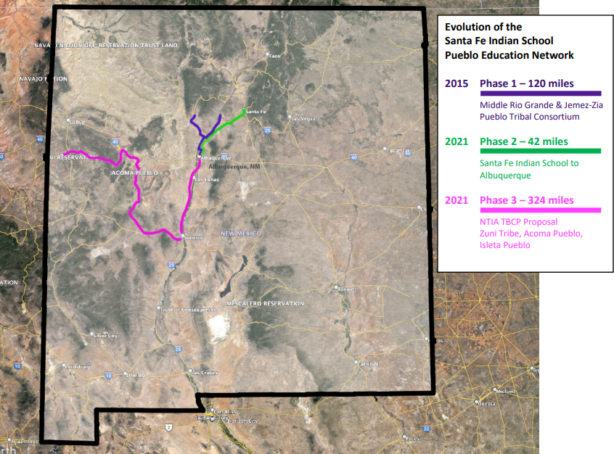
FAST-41 Covered Tribal Project Santa Fe Indian School Pueblo Education Network
$57 Million
300+ miles
Tribal Broadband Connectivity Program
Notes:
Pheobe/Kimball

Slide 9
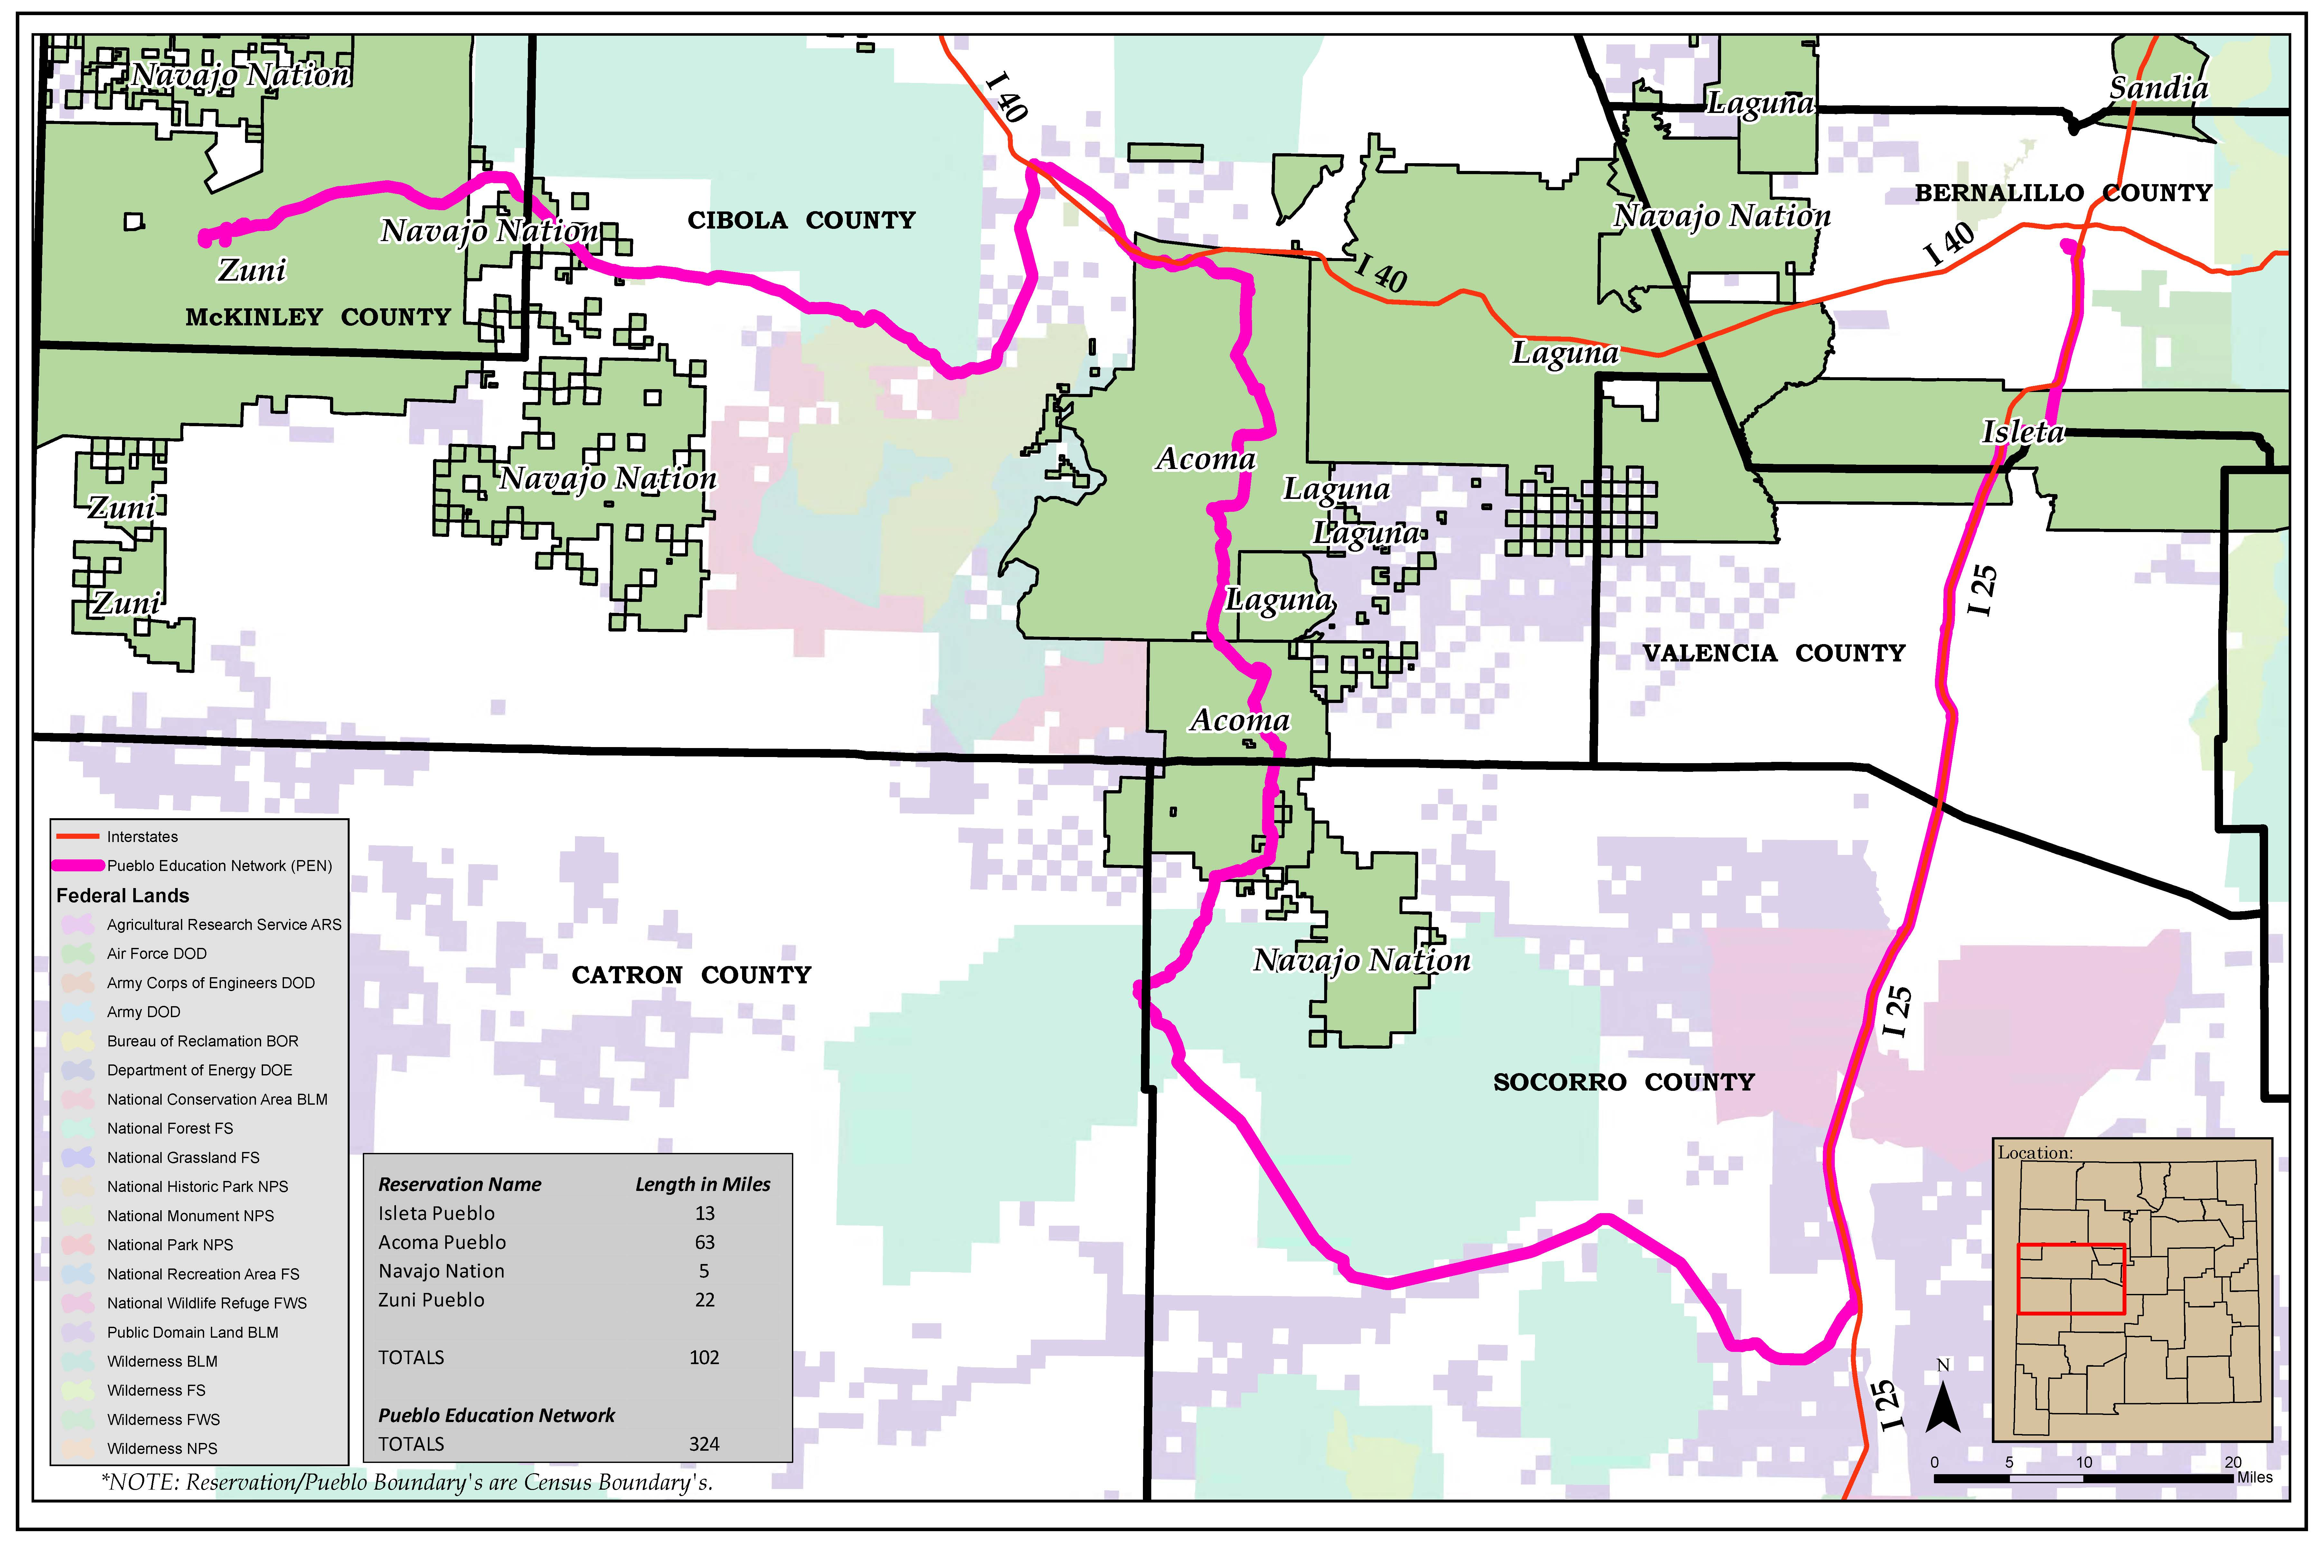
FAST-41 Tribal Project Santa Fe Indian School Pueblo Education Network
Tribal Partners:
Isleta Pueblo
Acoma Pueblo
Zuni Pueblo
Middle mile broadband infrastructure for Tribes and effectuating last-mile internet access
Modernizes Indian Education by creating a private education network
Notes:
Pheobe Kimball

Slide 10
Contact Information
For additional questions contact:
PoQueen Rivera
Director of Tribal Affairs
Federal Permitting Improvement Steering Council
Mobile: (202) 880-5366
E-mail: poqueen.rivera@fpisc.gov
For more information go to:
www.permitting.gov

