Slide 1
City of Albuquerque’s
First-ever Broadband Office
Established 2022
1
Notes:
Presentation Opener Slide

Slide 2
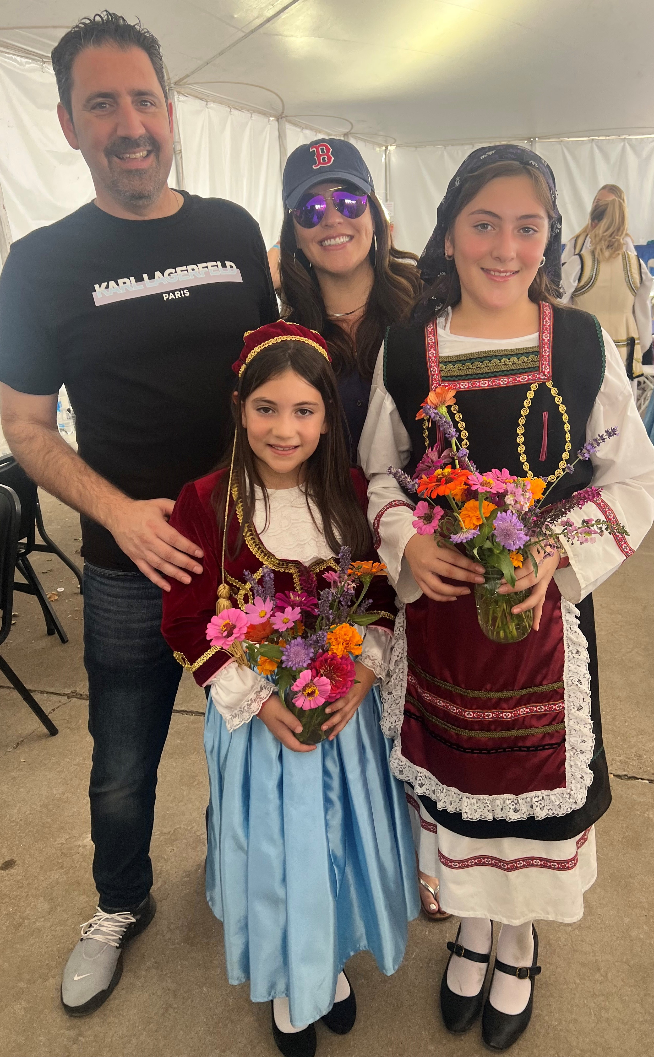
About Me
2
Notes:
Basic Layout (right)

Slide 3
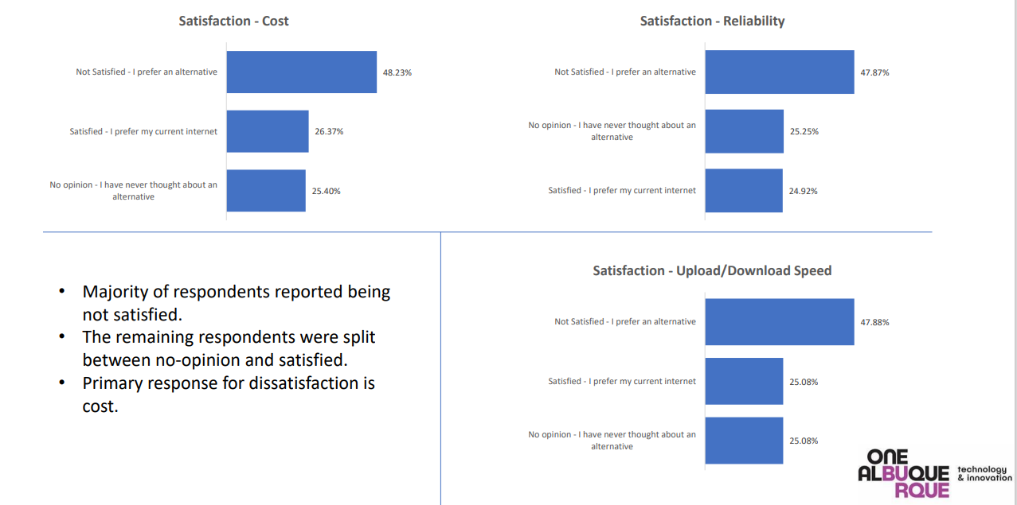
The need for a City broadband office
6
Notes:
Layout (left)

Slide 4
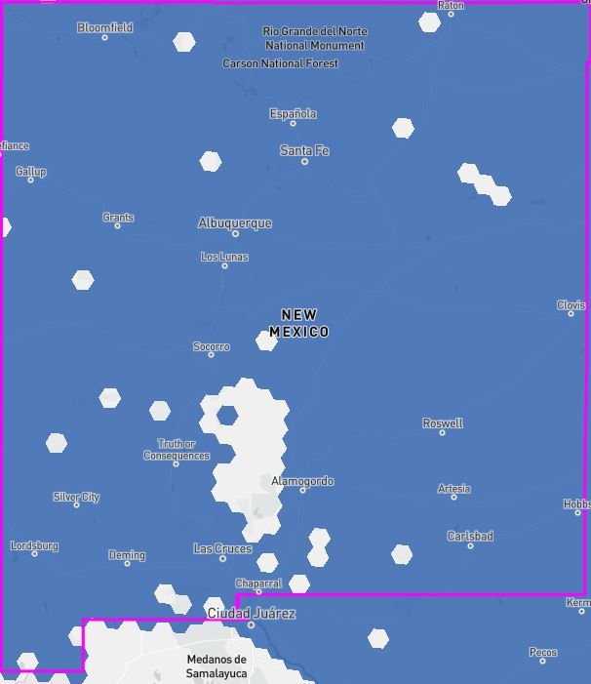
Together, we are broadband strong
5
Notes:
Layout (left)

Slide 5
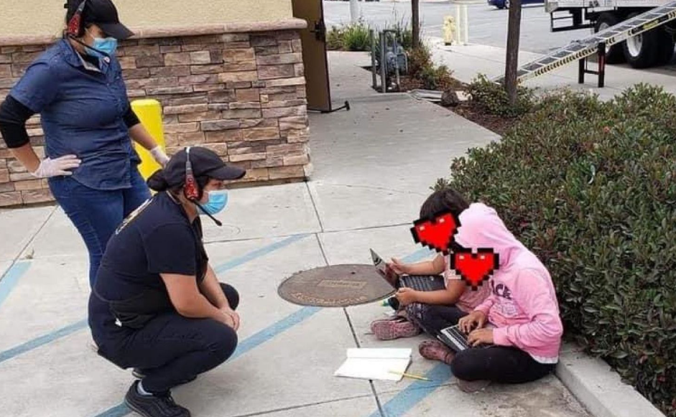
Albuquerque Broadband
Copper
DSL
Cable
Wireless
Satellite
16.5% poverty rate
National average is 12.4%
“We have no high speed internet providers. Working from home is severely limited. Virtual medical care is also not an option.” (December 5, 2023)
11
Notes:
Layout (left)

Slide 6
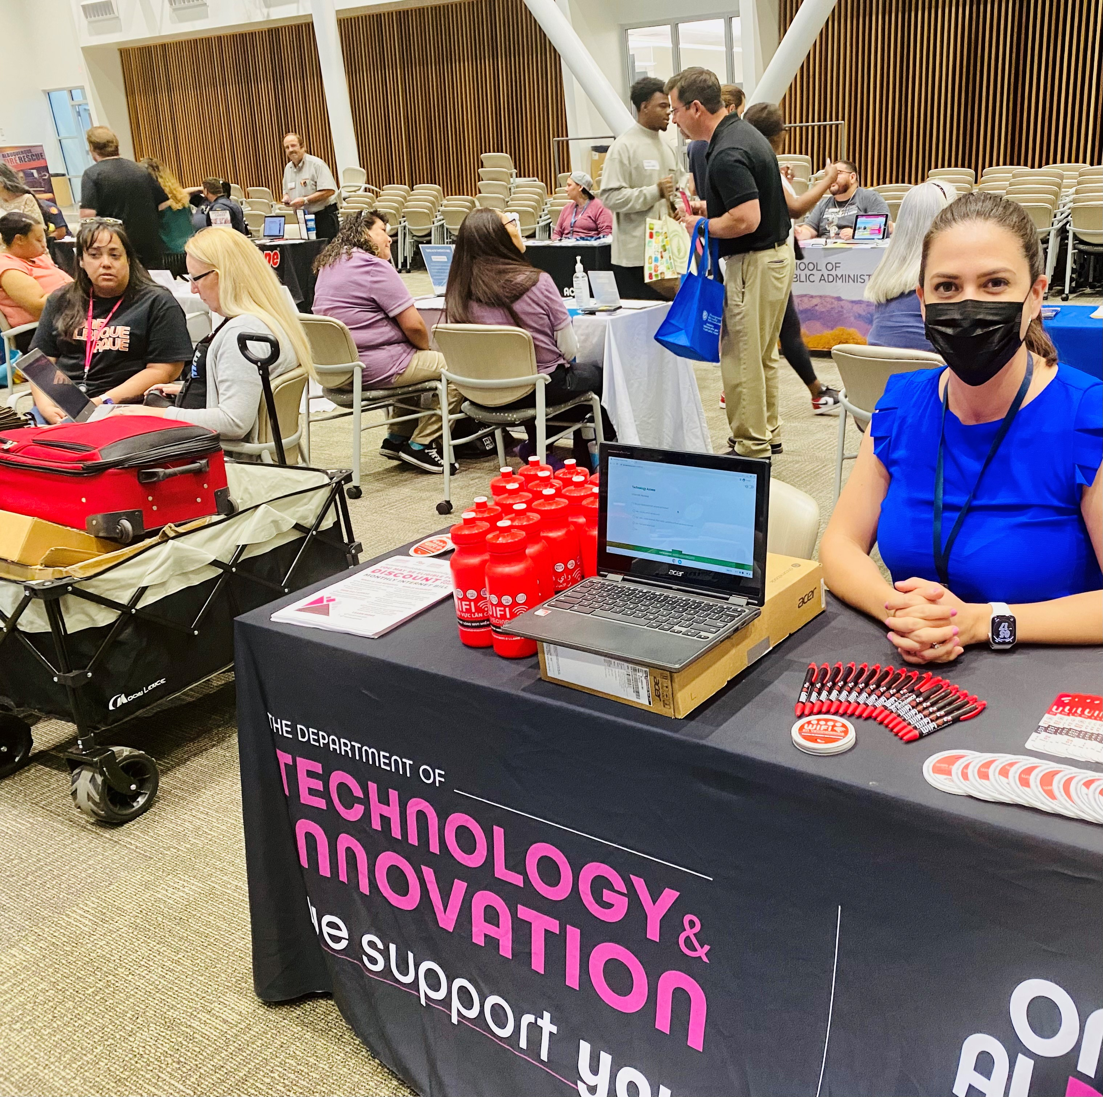
COA Broadband Mission
To ensure all residents, businesses, and industries have access to high-quality affordable broadband services, devices, and digital equity resources in a competitive marketplace where everyone can thrive now and into the future.
Albuquerque
4
Notes:
Layout (left)

Slide 7
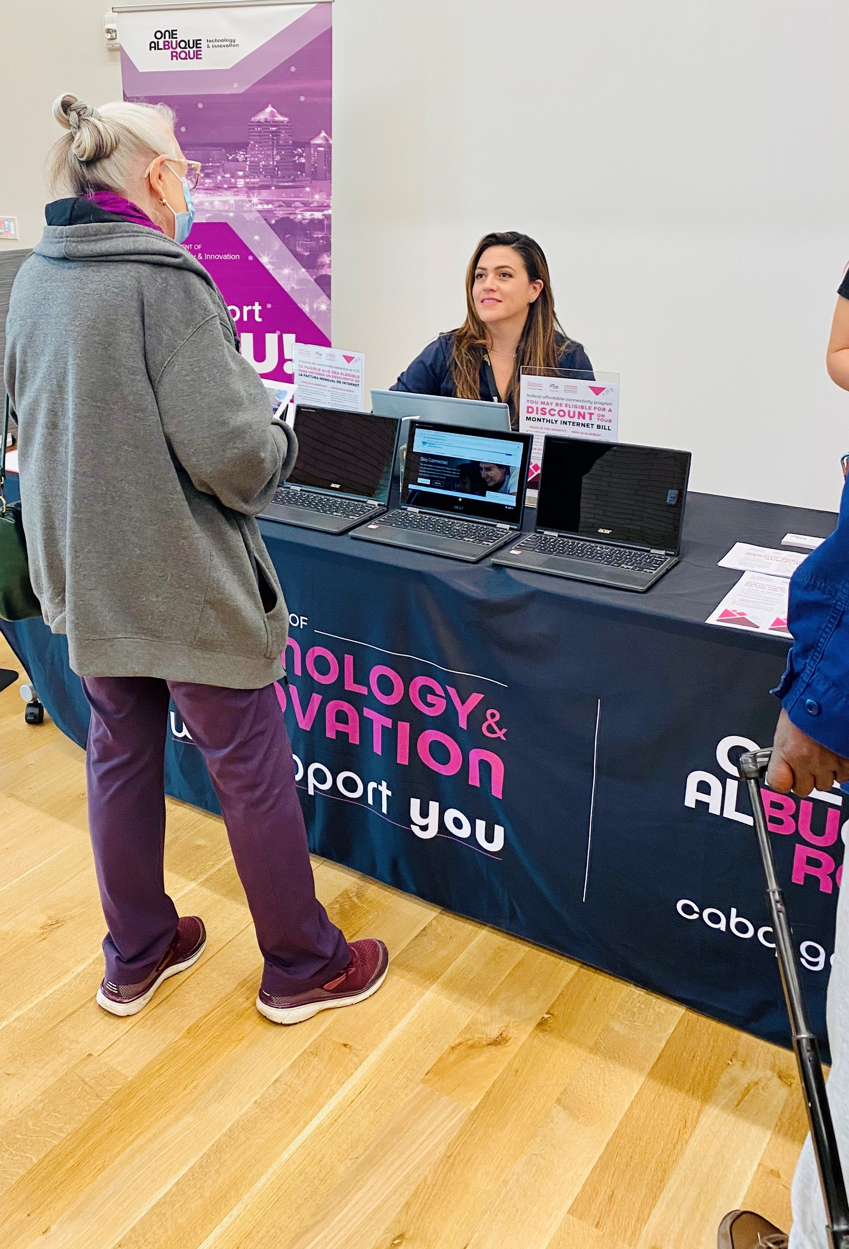
My role
The community is my stakeholder.
Access
Competition
Affordability
Devices
Digital Equity resources
3
Notes:
Basic Layout (left)

Slide 8
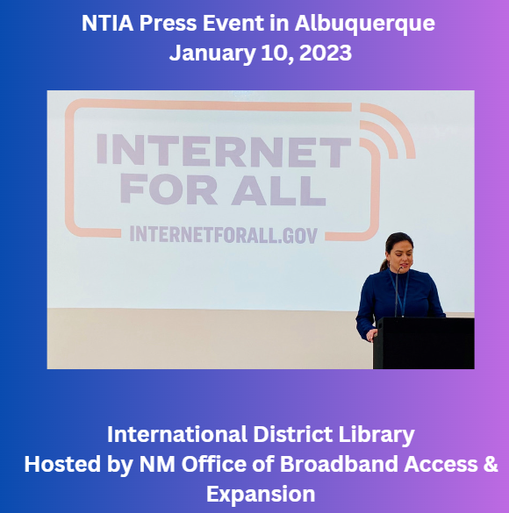
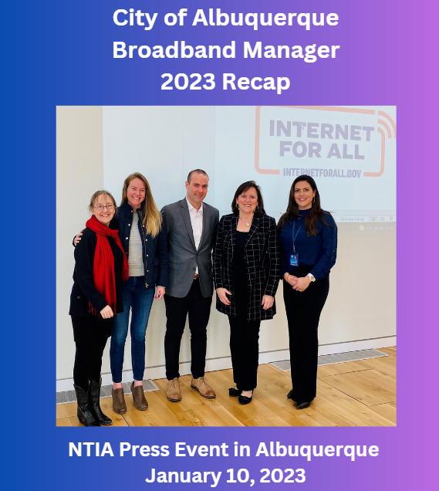
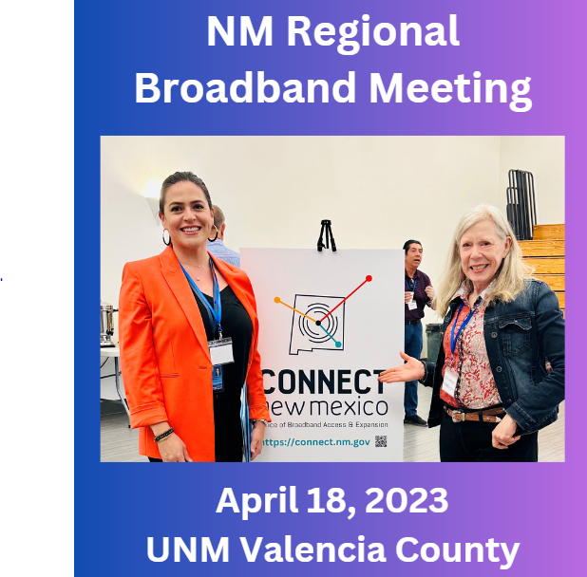
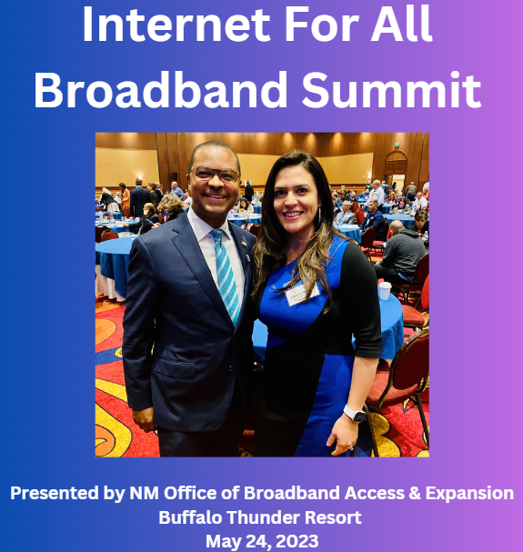
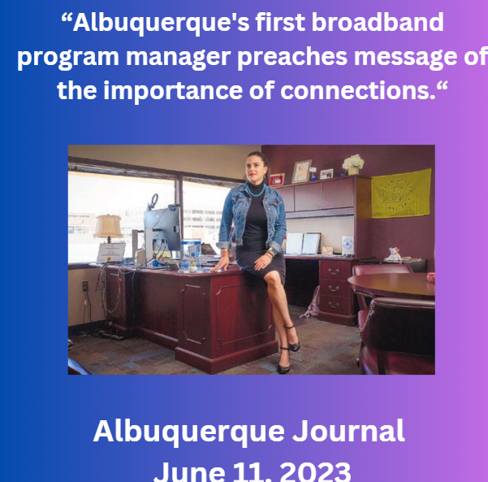

Slide 9
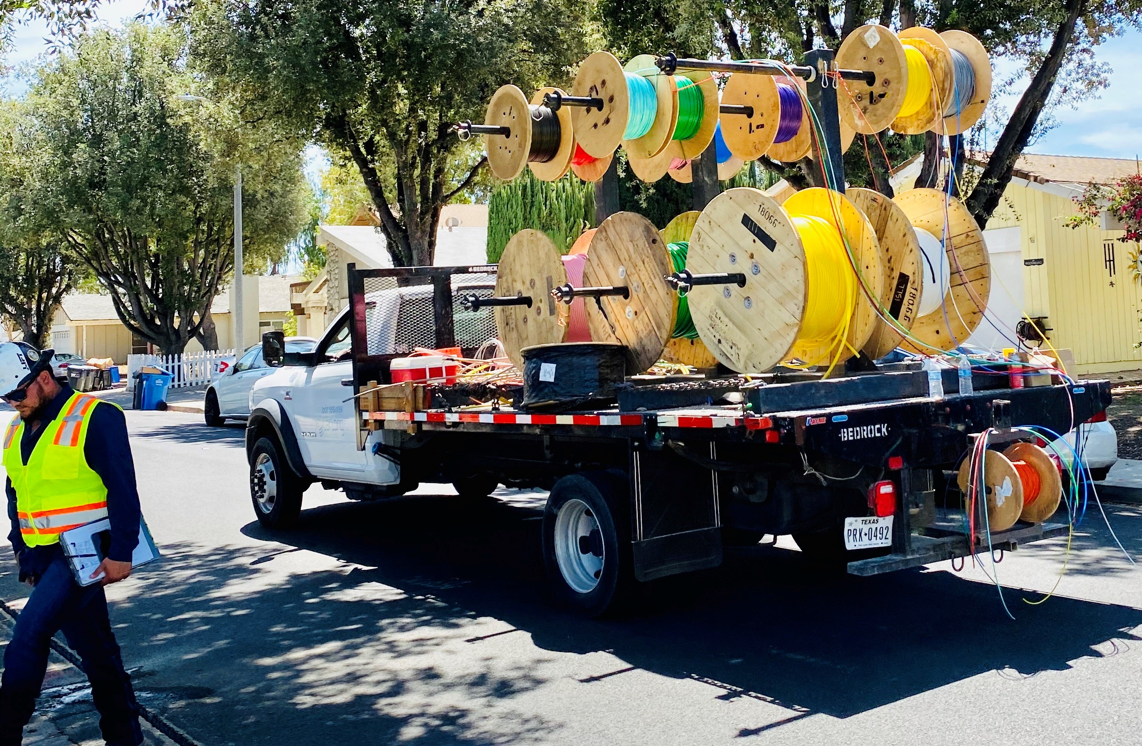
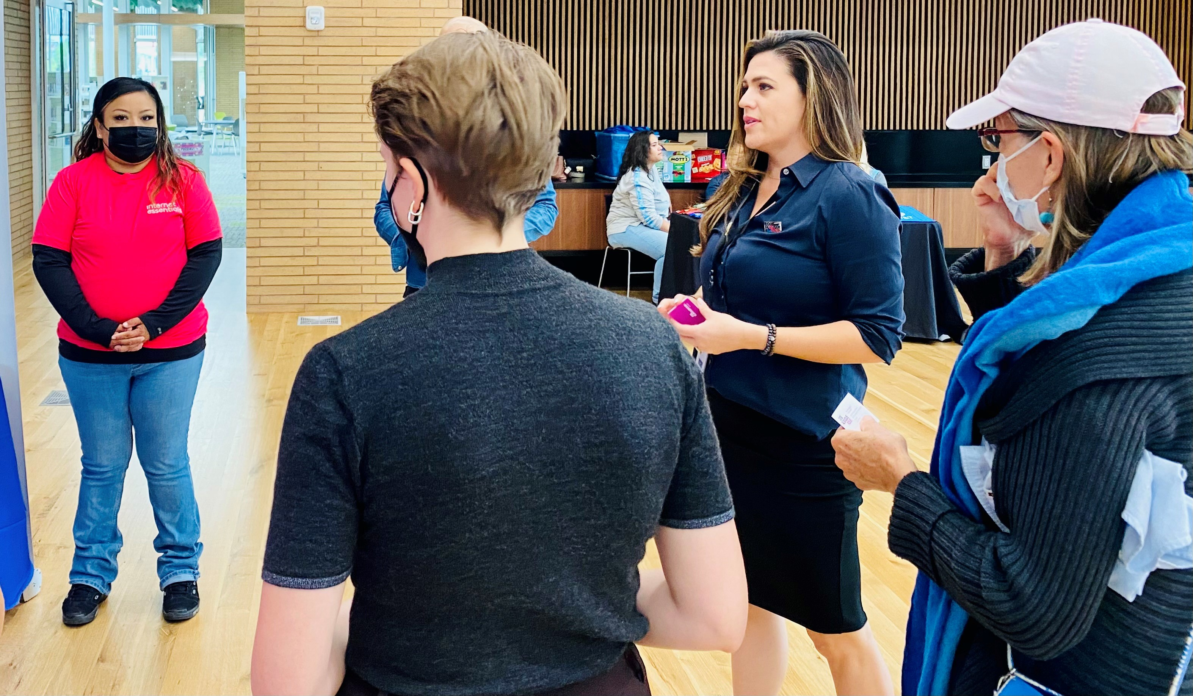
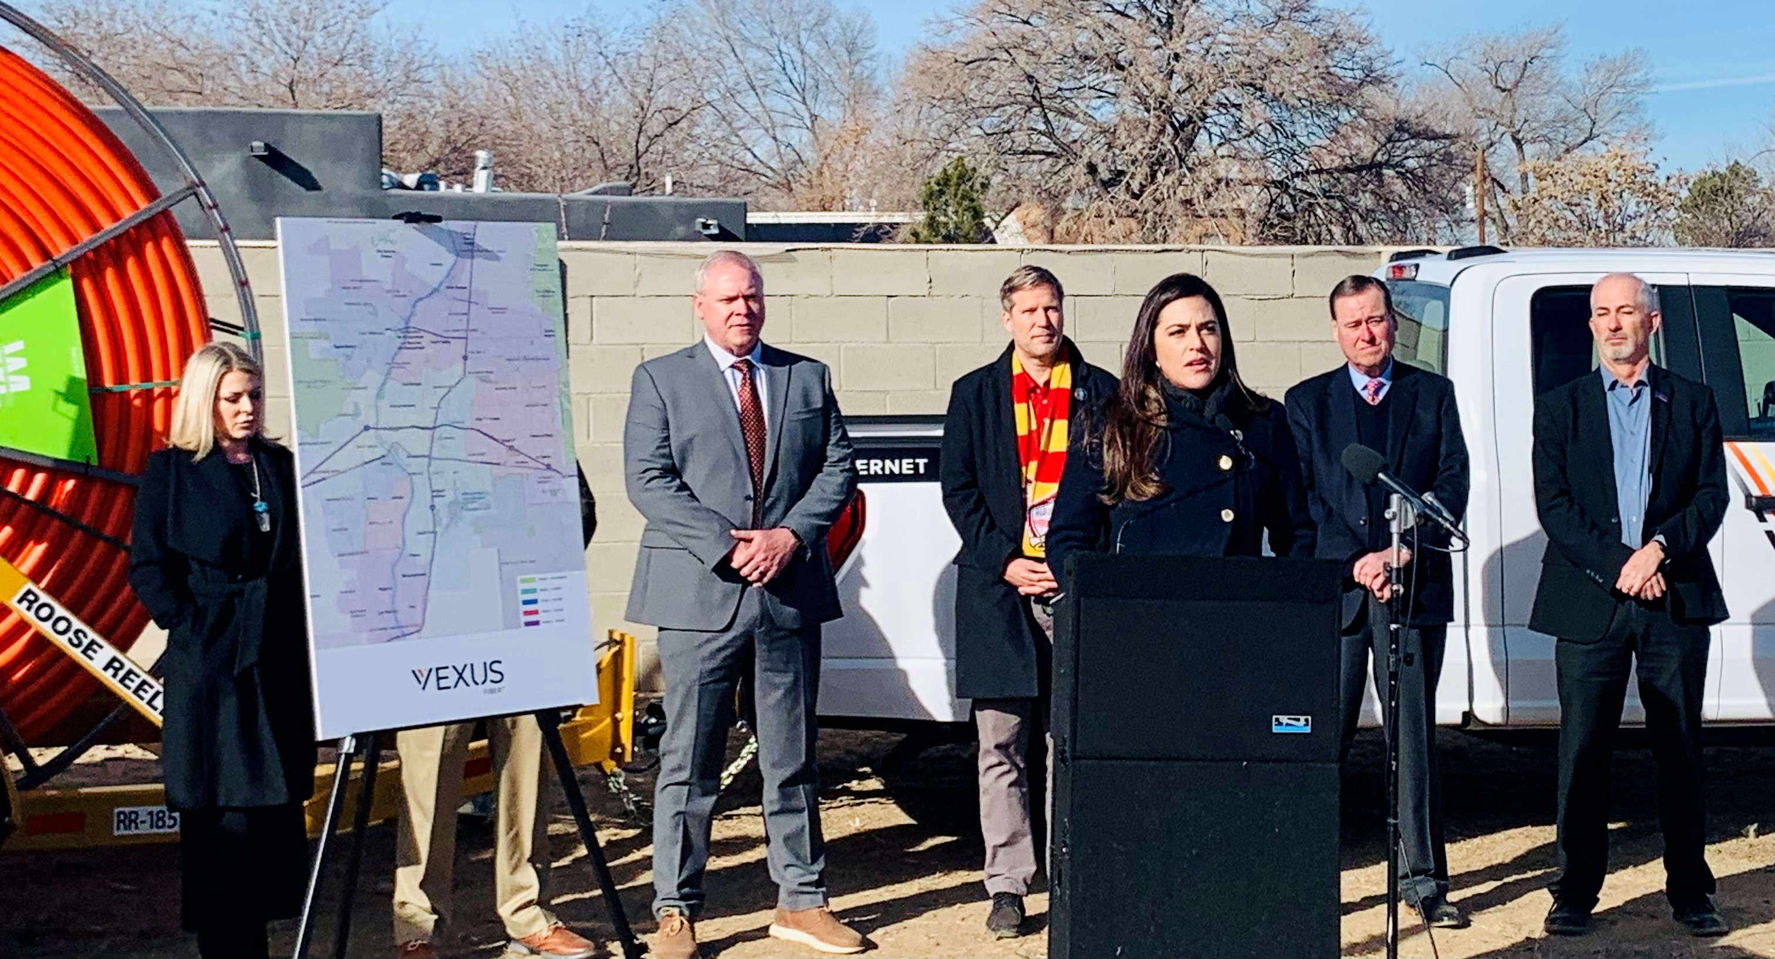
Making Broadband Competitive Public & Private Partnership
Private: Multiple companies to:
Offer competitive rates
Offer competitive services
Expand service areas
Contribute to local and surrounding economy
7
Notes:
Layout (left)

Slide 10
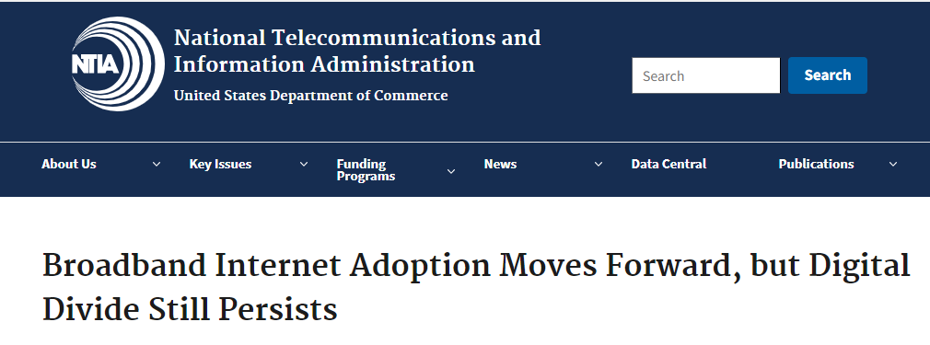
Adoption and Use
6
Notes:
Layout (left)

Slide 11
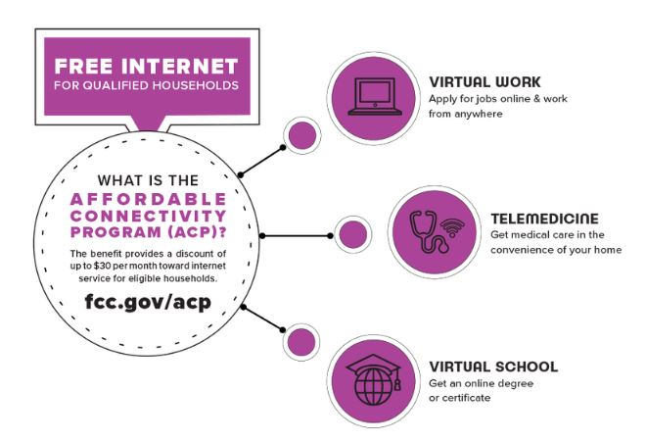
FCC’s Affordable Connectivity Program $30 a month discount on internet
9
Notes:
Layout (left)

Slide 13
Digital Equity
Digital equity is only achieved when all residents, regardless of their income, education, or background, have access to high-quality affordable broadband internet services, devices and digital literacy resources. Even then, digital equity will mean something different for each person and each household. At the core of digital equity, is the ability to live our lives with dignity.
Catherine Nicolaou
City of Albuquerque
Broadband Program Manager

Slide 14
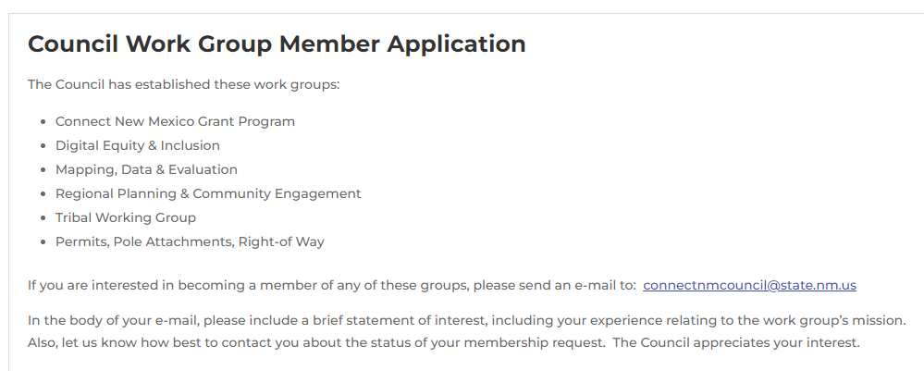
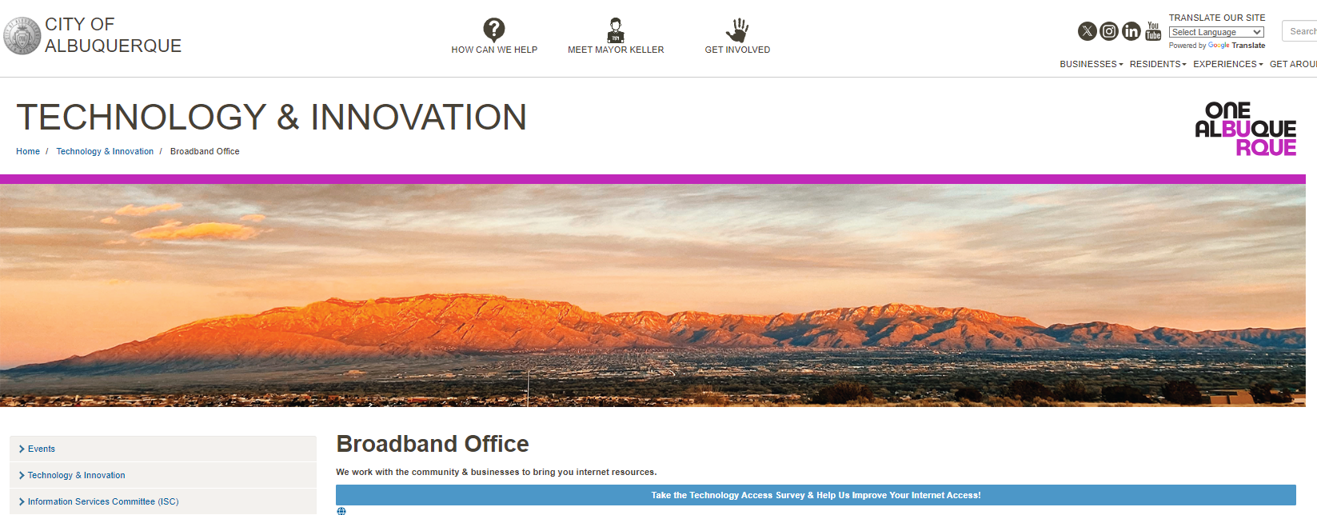
How you can help
Broadband Office — City of Albuquerque (cabq.gov)

Slide 15
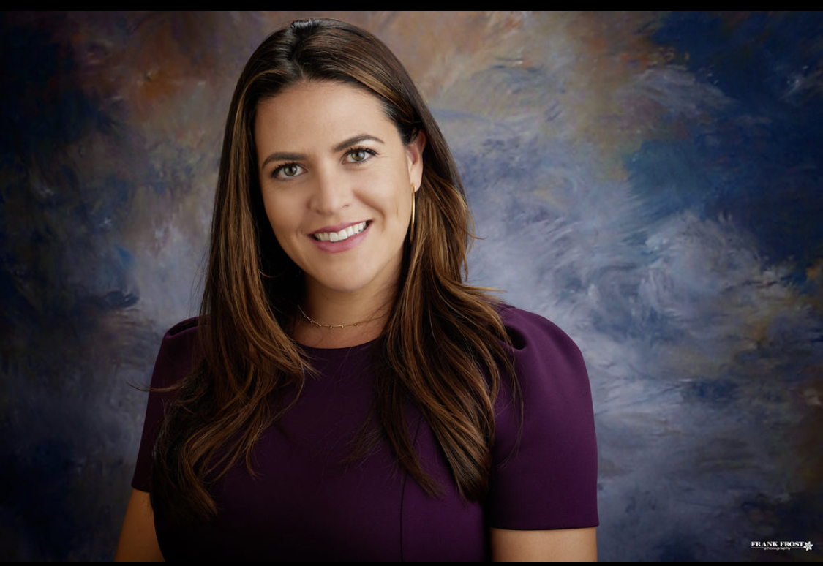
Questions
Contact
Catherine Nicolaou, Broadband Program Manager
Phone: 505-481-6876
Email: cnicolaou@cabq.gov
Catherine Nicolaou
12
Notes:
Basic Layout (right)

