Slide 1

Grant Writing Workshop
December 13, 2023

Slide 2
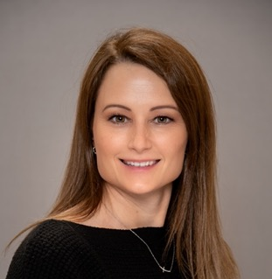
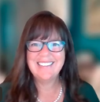
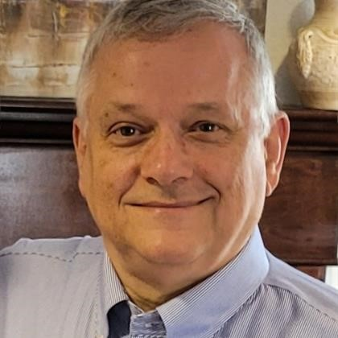



Our Speakers Today
Jessica Koch,
Sr. Manager, Industry Associations & External Affairs
Amanda Molina,
Director Business Development
Joe Carella,
Director of Grants, PMP

Slide 3


OUR MISSION
Our broadband platform and teams enable broadband service providers of all sizes to simplify their business and excite
their subscribers to grow the value of their
business for their community for generations.

Slide 4
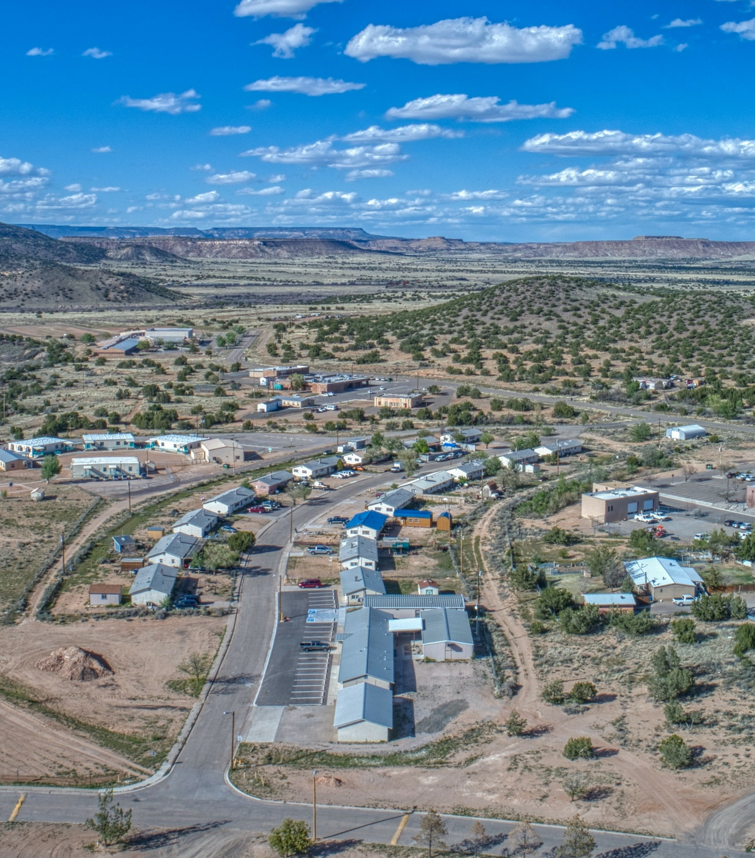
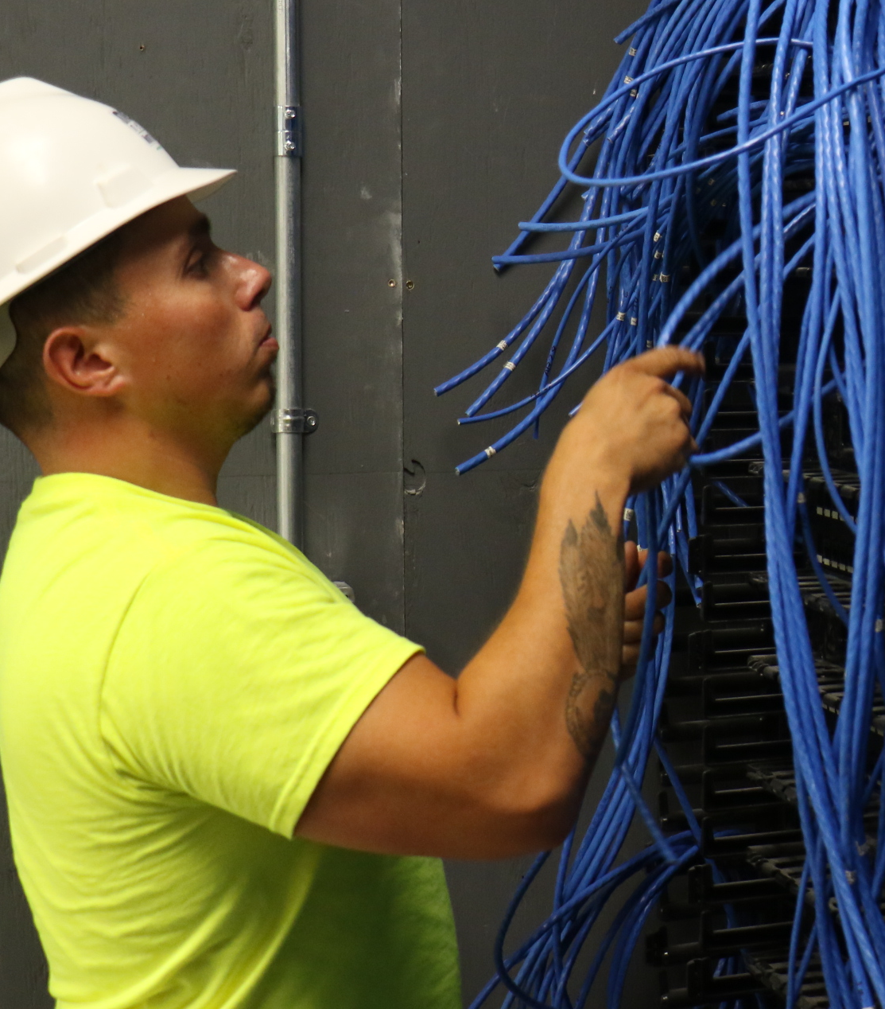

Do we have the center image with
the abstract overlay on it?
OUR PURPOSE (WHY)
Transform
Society
Innovation and
Empowerment
Smart, Safe,
Sustainable
Notes:
Subscribers – We are enabling subscribers
to live a richer, safer, more connected life.
Communities – We are improving
the economical viability of communities
enabling growth and attracting new residents,
new investment, and new businesses.
Sustainability – Our platform is the foundation of next generation broadband networks and home Wi-Fi networks that are 50-75% more energy efficient than legacy models.
We are committed to making the investments necessary to ensure our customers have the capabilities and expertise required to transform their businesses and communities.

Slide 5







Every community, no matter how small, should be able to
Communities should be
able to maintain and
Patients in rural communities should have access to the best
Grow
Sustain
Care
via efficient, simple-to-use
broadband connectivity.
the best standards with fast broadband.
through Telehealth.
Students should have access to
Parents should have the tools to
Families should feel
Secure
Learn
Protect
online and their personal information should be protected.
from the comfort of their home.
their kids from malicious content.
Notes:
Help you achieve these objectives:

Slide 6

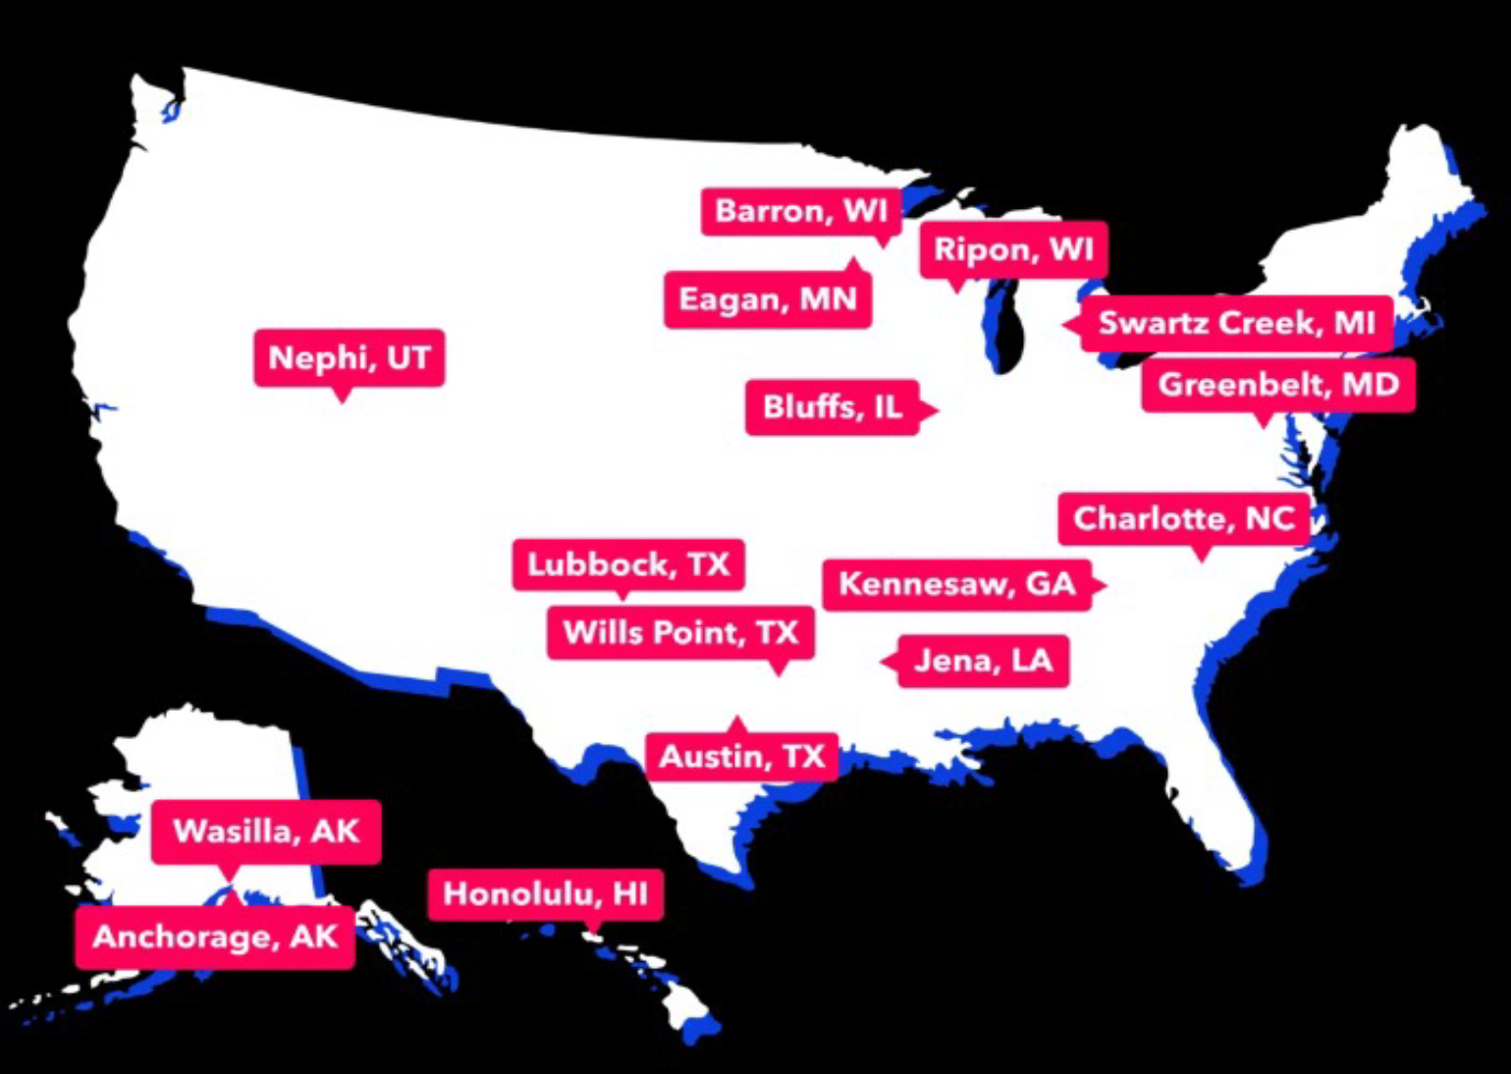
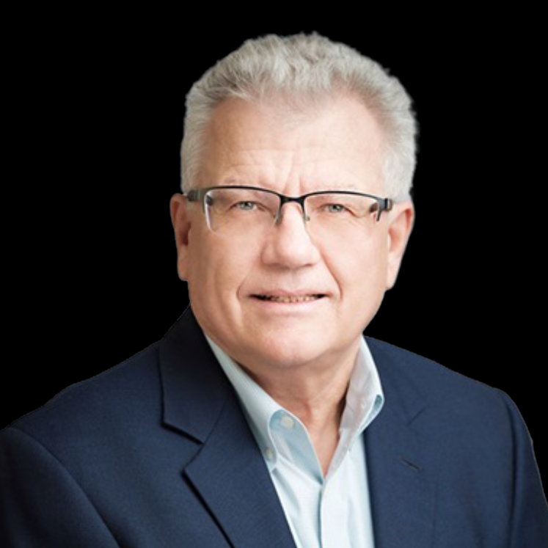
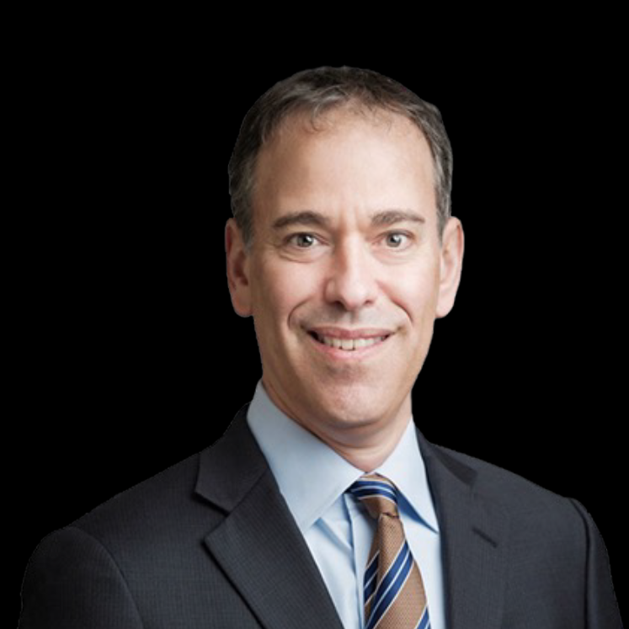
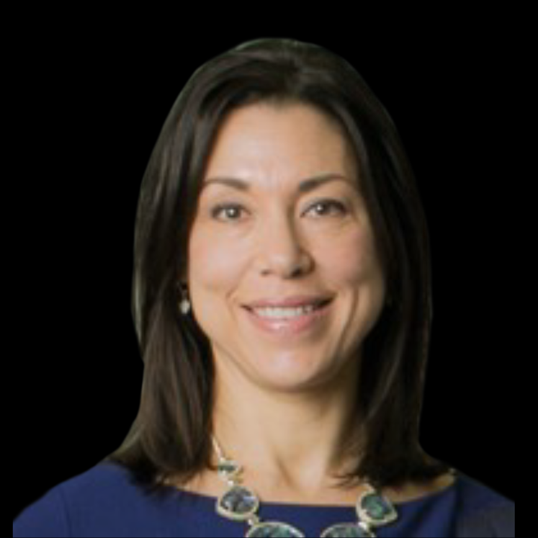
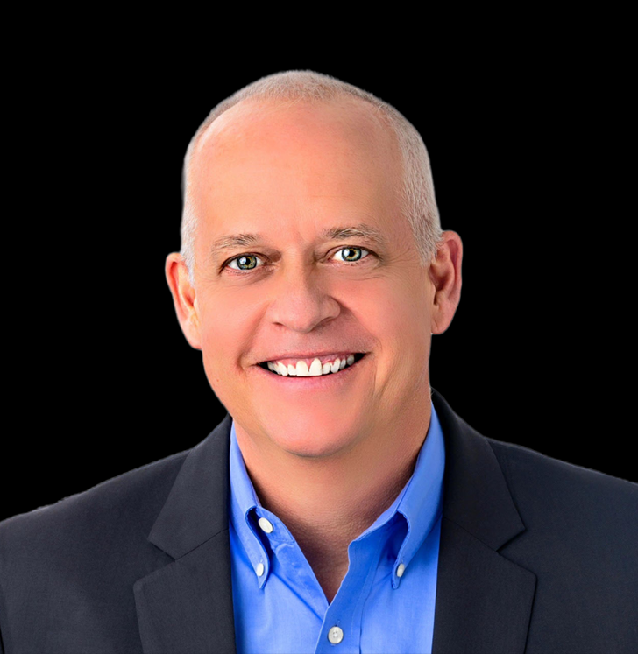
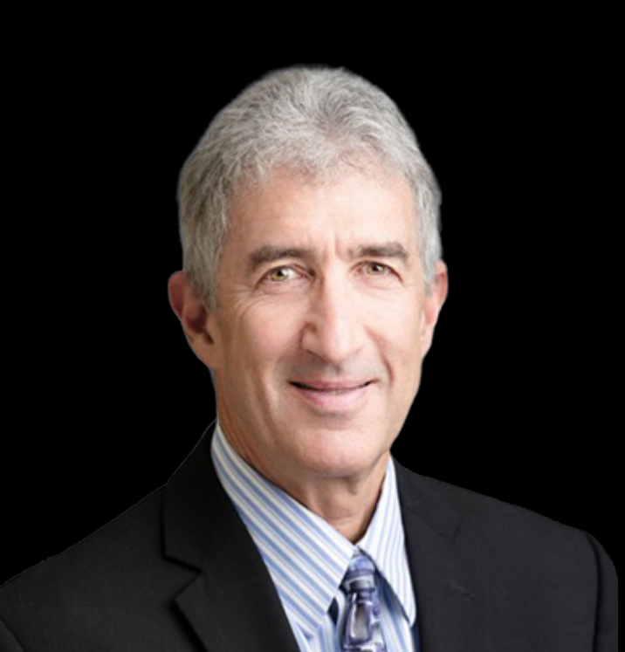
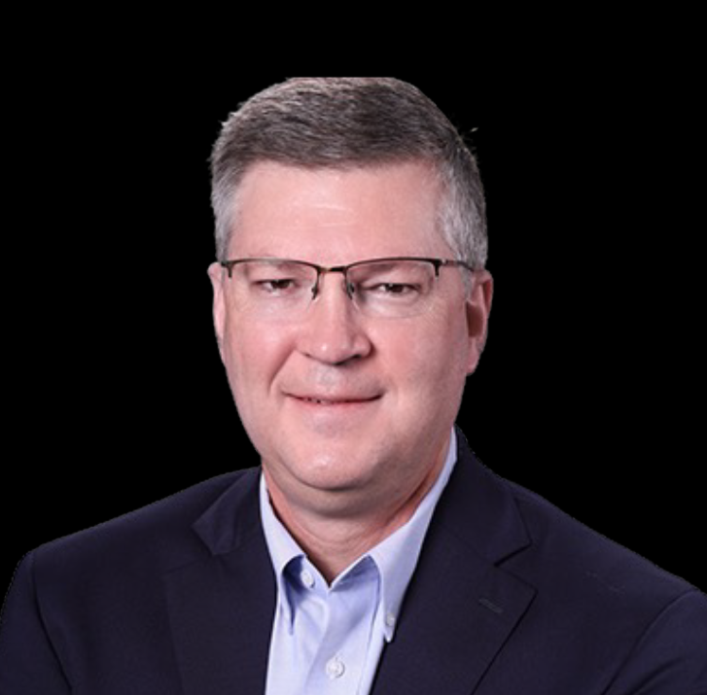
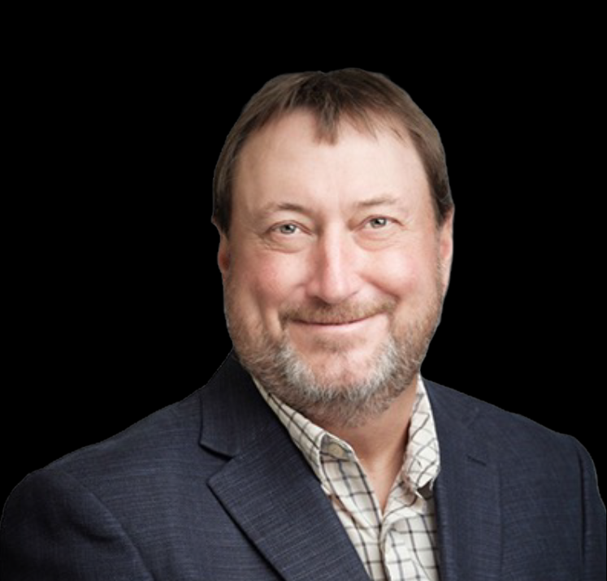
Complete Broadband Solutions
60 Years of Expertise
760+ Customers
600+ Employees
Average Tenure of 11+ Years
JSI is the leading Business and Engineering Platform for Rural Broadband.
Executive Team
Tasos Tsolakis
CEO
Dan Freiman
CFO
Michele Friedman
COO
Patrick Gault
CRO
Steve Meltzer
President
Regulatory & Compliance
Tom Lewis
SVP Broadband
Network Engineering
Vance Gadd
SVP Fiber Design
& Implementation

Slide 7
Building a Differentiated End-to-End Solution
Partners Across the Lifecycle
Managing Network Technology
Strategic Planning/ Feasibility Studies
Competitive Studies
Maximize Funding
Designing/ Engineering Networks
Project Managing Buildout of Network
JSI leverages cutting edge technology across its solution set to drive further value to its customers in a more efficient and higher velocity way.

Slide 8
• Valuations & Corporate Transactions
• Business Analytics/Peer Group Studies
• Service & Bundling Cost Analysis
• Financial, Regulatory & Network Audits
• Cybersecurity Audits & Training
• Disaster Prevention & Recovery Training
• Broadband Funding Application Support
• Broadband Service Mapping
• High-Level & Detailed Fiber & Network Designs
• Feasibility Studies/Business Cases
• Multi-Year Financial Forecasts
• Federal & State Advocacy
Optimize
Plan
Life Cycle Solutions
• Network Management Service (NOC+)
• DDoS Mitigation
• Layer 2/3 Switching/Routing Service Management
• Numbering & Porting/SOA & AOCN Services
• State & Federal Compliance & Reporting
• Cost Separations Studies/Continuing Property Records
• Fiber Construction Management
• Broadband Network Mapping
• Broadband Network Engineering & Deployment
• Service Pricing/Tariff Development
• Regulatory Filing Support
• Billing Systems & Related Services
Operate
Build

Slide 9


ENTRUST’s Fiber and Broadband Experience
#Access67
Over 400 co-operatives, municipalities, and broadband providers and municipalities rely on Magellan to develop their strategies, and their fiber and broadband networks.
Purpose-built to support economic development, education, healthcare, smart city, and the “internet of things”.
Custom-designed fiber & broadband networks to achieve each community’s unique goals.
Customized financial and operational strategies.
Proven Process. Proven Results.

Slide 10
Life-Cycle for Fiber Planning
Where is YOUR organization?
Starting with feasibility study and grant strategy?
Working with Providers?
Starting with broadband network design, including fiber & wireless?
Starting with grant funding applications, to support design &/or implementation?
Where might ENTRUST meet to support you?
Technical, financial plans
Organizational sustainability
Construction management
Match and ILOC
Broadband Planning
Design & Engineering
Turnkey Implementation
Funding & Grants
Feasibility Studies
Market Assessments
Business Plans
Financial Plans
Roadmaps
Fiber To The Premise
Backbone Fiber
Electronics
4G/5G
Rapid Design
Procurement
Project Management
Construction Mgmt.
Inspections
Launch
Operations
Over $400M Awarded
Funding Strategy
Grant Writing
Compliance & Ongoing Oversight
Post-award services

Slide 11
Jessica Koch,
Sr. Manager, Industry Associations & External Affairs
Amanda Molina,
Director Business Development
Joe Carella,
Director of Grants, PMP

Slide 12
adfdadffaa
Thank You

