Slide 1
New Mexico Office of Broadband Access and Expansion (OBAE)
New Mexico Broadband Summit
December 13, 2023
Drew Lovelace, Acting Broadband Director
(505) 795-1672
Drew.Lovelace@connect.nm.gov

Slide 2
Thank You!

Slide 3
Discussion Points
Topics
OBAE Background
Broadband 101
OBAE Successes
Programs
Broadband Equity Access and Deployment (BEAD)
Timeline
Definitions
Priorities
Unserved Map
Challenges
Legislative Priorities
Workforce development
Capital investments
Support services
What Can We Do
Additional Resources

Slide 4
OBAE Background
Created in 2021 Legislation the Office got started in June 2022.
Captured $780M in Federal Funding
Managing $170M in State Funding
Vision: Achieve enterprising, affordable broadband solutions for New Mexicans that honor the state’s rich heritage and elevate quality of life for all
Values: Seven values defining OBAE’s people, processes, planning, and programs:
courageous
honest
curious
innovative
respectful
collaborative
analytically rigorous

Slide 5
OBAE Background
OBAE Act and Connect New Mexico Act
Technical Assistance
Statewide Broadband Maps
Broadband Grants and Programs
Broadband Rights of way and permits
Middle Mile Provider of last resort
Digital Equity
By Memorandum of Understanding
State Education Network

Slide 6
Broadband 101: Why Broadband
Broadband touches every part of our lives.
Health
Telehealth visit
From home
From clinic
Specialists
Reduced Wait times
Reduced wait times
Education
State Education Network
Connect schools with one another
Connect children to resources
Online education Opportunities
Flexibility
Tutoring
Language services
Digital Equity
Entertainment
Streaming
Gaming
Music
Books
Business
Credit Cards
Support Services
Sales
Remote/Hybrid Work
Other: Quality of Life
Government Services: E-Government, taxes, etc
Real Time Communications
Internet of Things
Security systems
Shopping
Commerce

Slide 7
Broadband 101
Definition: Broadband is high-speed internet access that allows fast data transmission.
Analogy: Think of it as a wide, fast highway for data
Types of Broadband
DSL: Uses phone lines.
Cable: Through TV cable.
Fiber: Fast, via optical cables.
Wireless: Over the airwaves (like mobile data).
Satellite: Via orbiting satellites.
How Broadband Works
Data Transmission: Bits of data sent in packets.
Speed: Measured in Mbps (Megabits per second).
Uploading and Downloading: Two-way communication.
Latency: Time delay (lower is better).
Why Broadband Matters
Connectivity: Links people, businesses, and government.
Education: Enables online learning.
Economy: Boosts businesses, especially in rural areas.
Healthcare: Telemedicine and patient data.
Government Services: E-Government, taxes, etc.
Challenges and Gaps
Rural Areas: Limited access due to infrastructure.
Affordability: Not everyone can afford it.
Digital Literacy: Understanding how to use it.
Data Security: Protecting personal information.

Slide 8
Broadband 101: Technology Types
Wireless:
Data transmitted through airwaves.
Slower speeds (typically in Mbps).
Shared bandwidth, can be affected by network traffic.
Prone to interference (e.g., weather, physical obstacles).
Higher latency (delay in data transfer).
Fiber:
Data transmitted via optical cables.
Only truly symmetrical tech type (e.g.,100/100 Mbps)
Faster speeds (often in Gbps).
Dedicated bandwidth, consistent performance.
Highly reliable, immune to most interference.
Low latency, ideal for real-time applications.
Satellite:
Data transmitted via orbiting satellites.
Slower speeds (typically in Mbps).
Shared bandwidth, affected by network congestion
Prone to interference (e.g., weather conditions).
High latency due to the distance to orbiting satellites.
DSL:
Data transmitted via signals carried over traditional copper phone lines.
Shares bandwidth with other users in the same neighborhood.
Slower speeds (typically in Mbps).
Prone to slowdowns during peak usage times.
Susceptible to interference, especially over long distances.
High latency, usually due to network congestion

Slide 9
Broadband 101: Typical Needs for Family of Four

Slide 10
Broadband 101: Future Needs Will be Higher

Slide 11
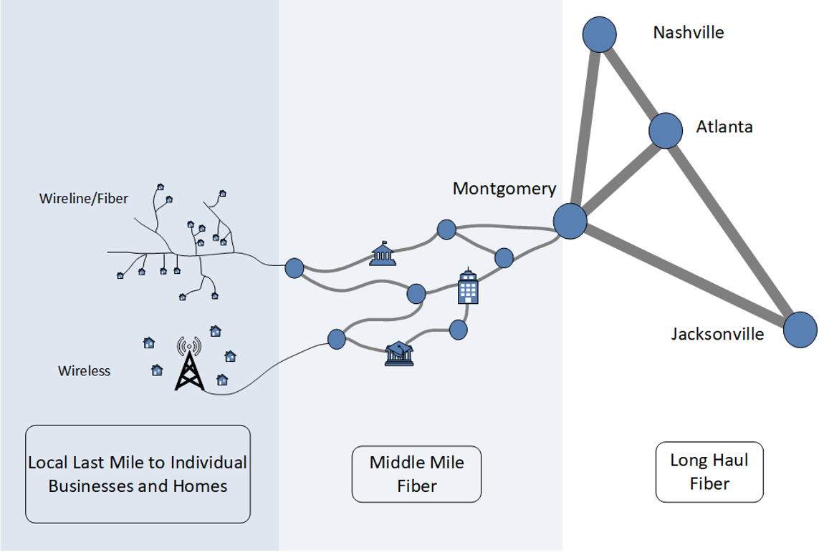
Broadband 101: Elements of a Broadband Network
Long haul fiber
Middle mile fiber
Last mile (wireline or wireless)
Albuquerque
Santa Fe
Wireline/
Fiber
Las Cruces
Phoenix
Wireless
Local Last Mile to Homes and Businesses
Middle-Mile Fiber
Long Haul Fiber

Slide 12
Broadband 101: Technology Adoption
https://ourworldindata.org/grapher/technology-adoption-by-households-in-the-united-states?facet=none&country=Electric+power~Landline~Microwave~Refrigerator~Cellular+phone~Television~Internet~Radio

Slide 13
OBAE Successes
Team is growing
September 2022 – 2 employees
September 2023 – 20 employees and growing
BEAD
22 of 23 Tribal consultations for BEAD are complete!
5-year strategy plan submitted
Initial Proposal Volume 1 posted for public comment
Connect New Mexico Fund
Apply now
Tribal Dashboard Taskforce
Dashboard

Slide 14
Connect New Mexico Fund $5 Million
Launched 10-18-23
Tribes
Local Governments
Electric Co-ops
Telco Co-ops

Slide 15
Announcement: Connect NM Fund
$70M Connect NM Infrastructure Fund

Slide 16
$70M Connect NM Fund
NOFO Launch: December 12, 2023
https://connect.nm.gov/connect-NM-fund.html
Submittable web portal will be open January 3, 2023

Slide 17
$70M Connect NM Fund
Similar to Connect NM Pilot Program
Designed to dovetail with Broadband Equity Access and Deployment (BEAD)
Special projects include communities impacted by wildfires
Added some challenge criteria for reliable unlicensed fixed wireless providers

Slide 18
Tribal Task Force
Launched 10-20-23
IAD
Pueblo of Cochiti
Pueblo of Laguna
Pueblo of Jemez
Shared with Tribal Leaders
Will update when additional public facing data is available

Slide 19
OBAE Successes: Upcoming
BEAD
Initial Proposal Volume 2
Public Comment November 15 comment
Initial Proposal Deadline
December 28
Digital Equity Plan
Public Comment December/January
Due February 13
3-Year Strategic Plan
Update January 1
Connect New Mexico Fund Infrastructure Grant
$70 M launch Q4
DOT
Middle Mile Project

Slide 20
Programs
2023 Programs
Connect New Mexico Pilot - $117M Awarded 2023
Grant Writing, Engineering Planning – $5M Open October 2023
Connect New Mexico Infrastructure Grant - $70M LAUNCHED TODAY
2024-2025 Programs
Broadband Equity, Access, and Deployment (BEAD) - $675M
Connect New Mexico School Infrastructure - $25M
Digital Equity – $??? NTIA Grant releasing Summer 2024

Slide 21
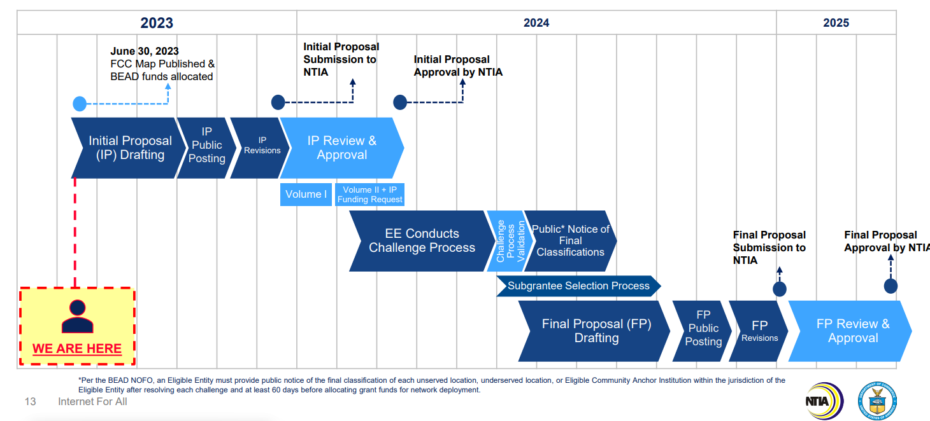
Programs: BEAD

Slide 22
Programs: BEAD
Definitions you need to know:
Unserved
25 download / 3 upload and below
Underserved
Between 25 download/ 3 upload and 100 download / 20 upload
Served
100 download / 20 upload and above
BSL – Broadband Serviceable Locations (building)
CAI - Community Anchor Institutions
MDU – Low Income Multi-Dwelling Units

Slide 23
Programs: BEAD Priorities
Priorities:
Unserved BSLs – 100%
Underserved BSLs
CAIs
MDUs

Slide 24
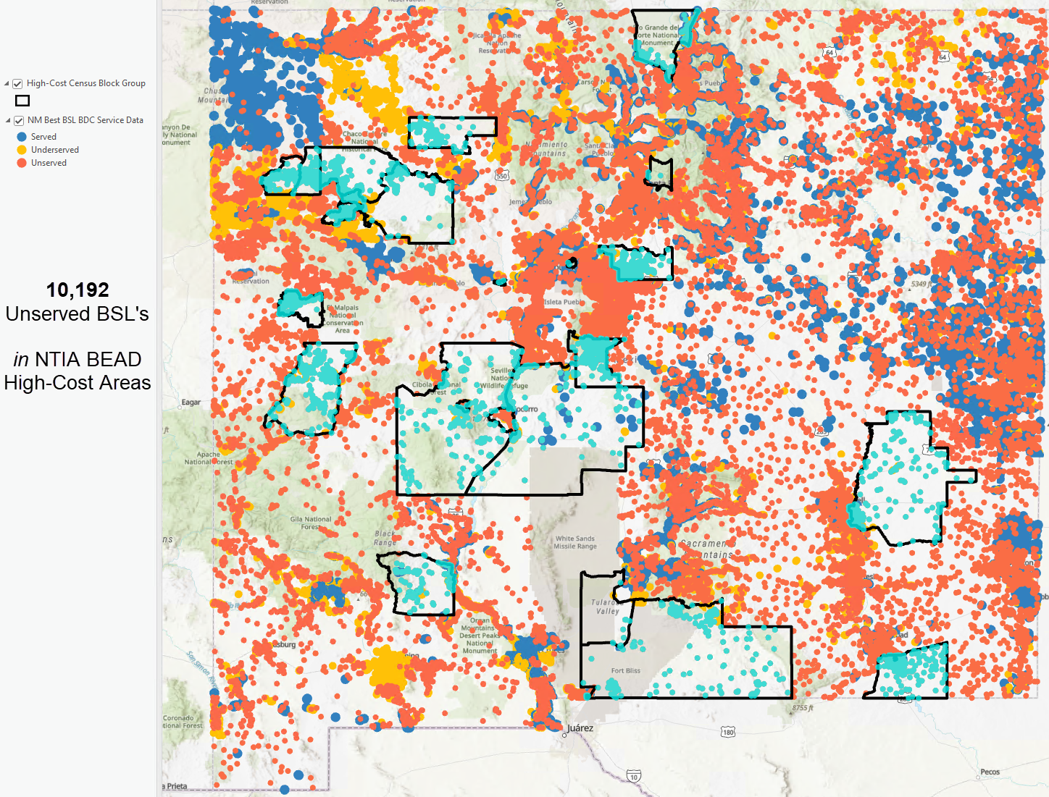
70k Unserved
10k Unserved in 24 High-cost areas

Slide 25
Challenges: 2023-2029
Infrastructure Funding
BEAD
$42.5 Billion dollars will be injected into 50 states and 6 territories
TBCP
$3B across all tribal nations
NEVI
$4.1 Billion for Electric vehicles across 50 states
Federal Highway Programs
$350 Billion for federal highways

Slide 26
Challenges: Labor Gap

Slide 27
Challenges: What this means for NM business
Over the next five years an estimated $3+ Billion dollars of infrastructure money will flow into NM.
Problem:
That is a lot of infrastructure all at the same time.
Employees
Skilled labor
Administrative staff
Accountants
HR
Equipment
Supply chain
Letter Of Credit

Slide 28
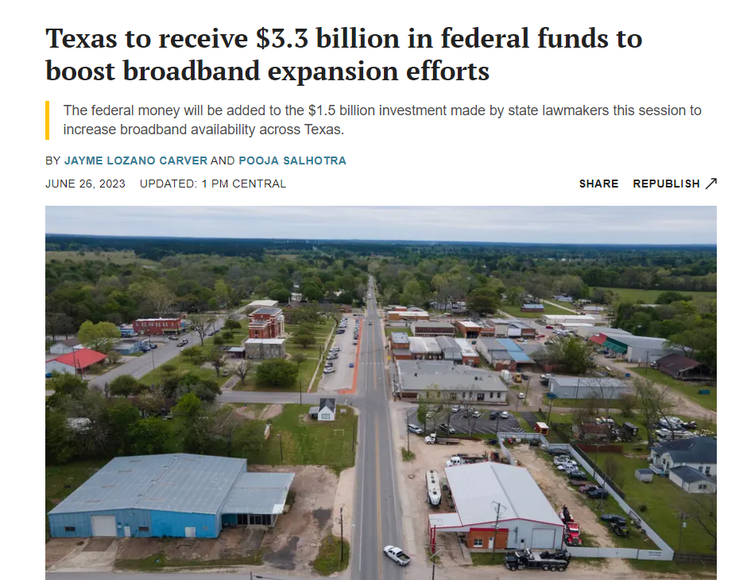
Challenges: Regional Competition
Texas is investing heavily in broadband (~$10B expected):
Spend more for:
Crews
Materials
Longer lasting technologies
Get to:
Underserved
Community Anchor Institutions
Low-income housing

Slide 29
Challenges: OBAE
Projected Infrastructure Gap - $230 Million
Programs - $20 Million
Grants writing
Network Operations and Cyber Security
State Education Network and Data Center
ACP Student Supplement Support
Workforce Development
Partnerships
OBAE’s mission is not every private entities mission

Slide 30
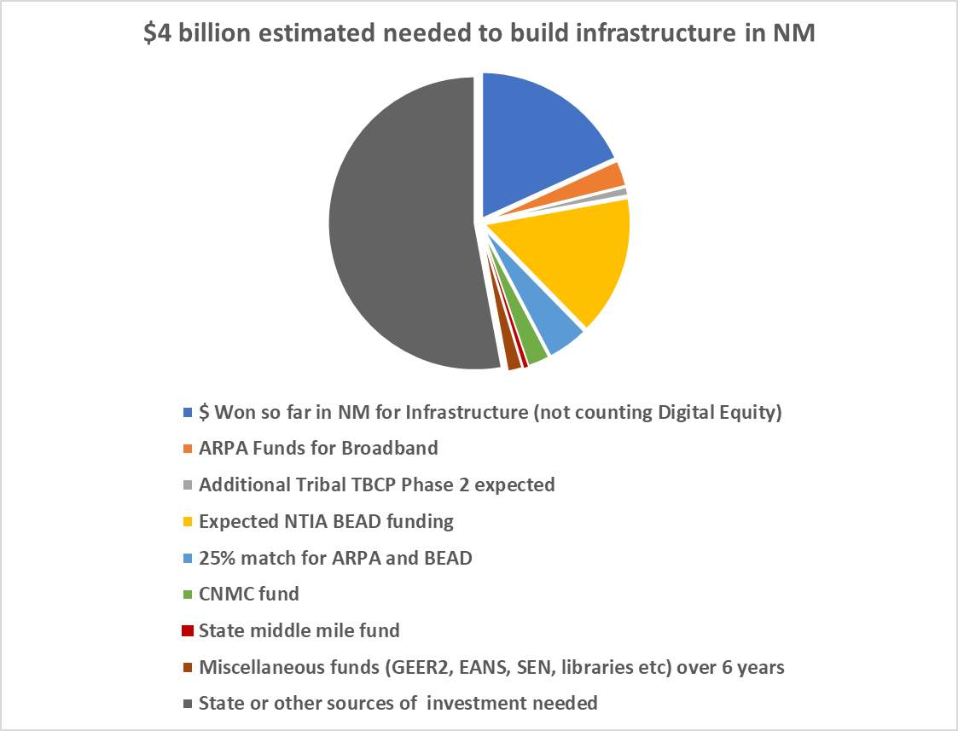
Challenges: Gap

Slide 31
Challenges:
ROW, Permits, Pole Attachments
Active Projects Being descoped
Unclear cost increases
Mapping
Better Data
Tribal Support
County Support
Supply Chain
Better Data
Tribal Support
County Support

Slide 32
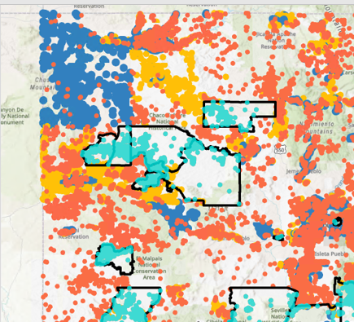
Challenges: Mapping
Served by Cable/fiber

Slide 33
Legislative Priorities
Financial Priorities
Operating Budget:
$8,087,200
Increase from $1.2M
20 Employees moving from STRM to PERM
5 Employees moving from PSFA to OBAE
$250,000,000 Connect New Mexico Fund
Programs and Grants
Infrastructure
Middle Mile
5G and Towers
Last Mile
Telehealth
Community Anchor Institutions
Match
Affordable Connectivity Program Supplement for Students
Workforce Dev

Slide 34
Legislative Priorities
2 Bill Priorities
OBAE operating autonomously
Address ownership (DoIT vs. OBAE)
PSFA SEN Program, Employees, Fund
Move employees
State Education Network
E-Rate School Support
$10 Million fund to Connect New Mexico Fund
ROW
Electrical ROW Easements used for Broadband
Rate structure pole attachment
Make Ready Costs

Slide 35
What Can We Do
Get Ready
Be Informed
Form Partnerships with
Companies
Tribal governments
Local governments
Plan ahead
Supply chain
Engineering/planning
Technical assistance
Match Money
Hire talent
Keep NM talent
Recruit talent from out of state
Apply
Build
Support

Slide 36
Questions?
Drew Lovelace is the Acting Director for the Office of Broadband Access and Expansion (OBAE). He is guiding the OBAE team in orchestrating statewide initiatives to proactively secure and allocate over $675 million in federal broadband funding. Additionally, he is championing efforts to bolster New Mexico's connectivity on a statewide scale. Drew possesses more than two decades of diverse private sector expertise, spanning industries such as Information Technology and the Outdoor Industry. In his recent four-year tenure, he has dedicated his skills to serving the State of New Mexico. Drew holds Bachelor's degrees in English Literature and History from the University of Colorado at Boulder, an MBA from the University of New Mexico, and maintains both SHRM-SCP and PHR certifications. Residing in Santa Fe and Chamisal with his wife, two children, and loyal dog, he finds joy in both work and family life.​​
Drew.Lovelace@connect.nm.gov
(505) 795-1672

Slide 37
Additional Resources
OBAE
https://connect.nm.gov/
Mapping
https://connect.nm.gov/nm-broadband-mapping.html
Tribal Dashboard
https://connect.nm.gov/tribal-broadband-resource-library.html
Broadband Project Video
https://youtu.be/Altg8BOP-Ww?si=v5v_nMbZDfGwAJwm
OBAE Team
https://connect.nm.gov/meet-the-obae-team.html

