Slide 1
FCC National Broadband Map
December 13, 2023
Eduard Bartholme, Senior Outreach Director
Broadband Data Task Force
Federal Communications Commission

Slide 2
Broadband Data Collection (BDC): New Approach to Mapping Broadband Availability
The FCC historically collected broadband deployment data at the census-block level. Large geographic scale meant a generalized view of deployment.
More reliable and consistent broadband availability data are critical to efforts to target public funds to connect unserved and underserved communities.
Congress directed the FCC to develop processes and procedures to collect, verify, and publish more granular data in the Broadband Deployment Accuracy and Technological Availability (DATA) Act.
The first draft of the new Map was published in November, 2022.
Notes:
Fixed broadband service providers have reported coverage based on Census Blocks.
11,000,000+ census blocks in the U.S., which vary in size, especially between urban and rural areas.
No way to distinguish which locations within a census block are served.
Mobile broadband providers have reported by technology and based on minimum advertised speed or speeds consumers should reasonably expect to receive within the coverage area.
Lack of standardized reporting parameters prevents apples-to-apples comparisons of data among providers.
BDC=
Entirely new filing/data-collection system
Fixed broadband availability data down to the individual location
Mobile broadband availability data standardized across providers
Challenge process to identify and dispute data collected from providers
Incorporation of data from state, local, and Tribal governments
Crowdsource information to support verification efforts
Audits and enforcement

Slide 4
National Broadband Map: Improvements in New Mexico
Fabric Improvements
New Mexico now has 27,243 more locations on the map.
Of those newly added locations, 14,809 were on Tribal lands.
Better Picture of Availability
New Mexico submitted over 175,000 challenges to provider reported availability.
Since the BEAD Allocation the number of unserved locations on the map has decreased.

Slide 5
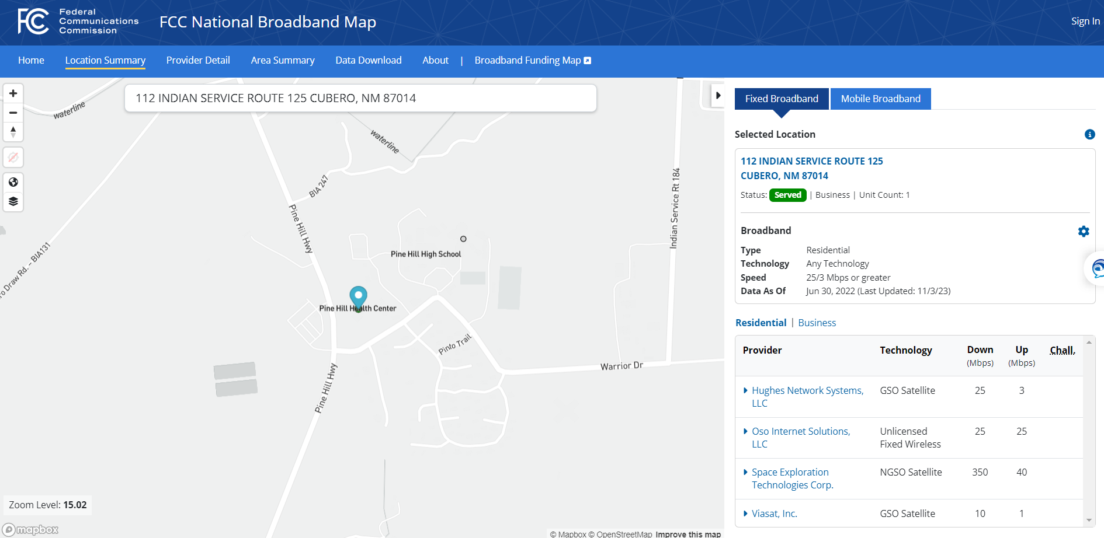

Slide 6
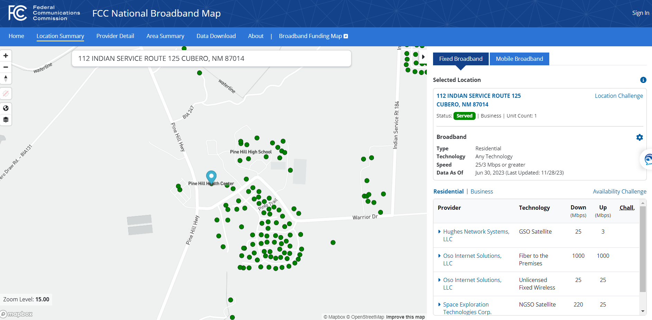

Slide 7
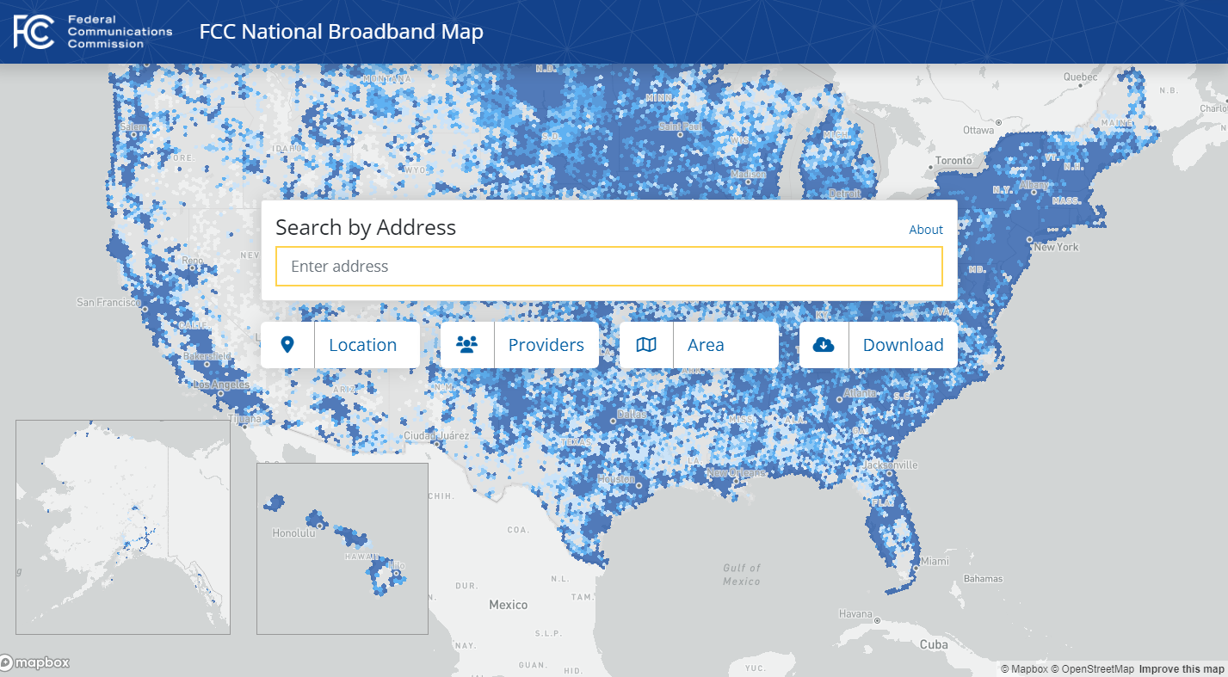
BroadbandMap.gov

Slide 8
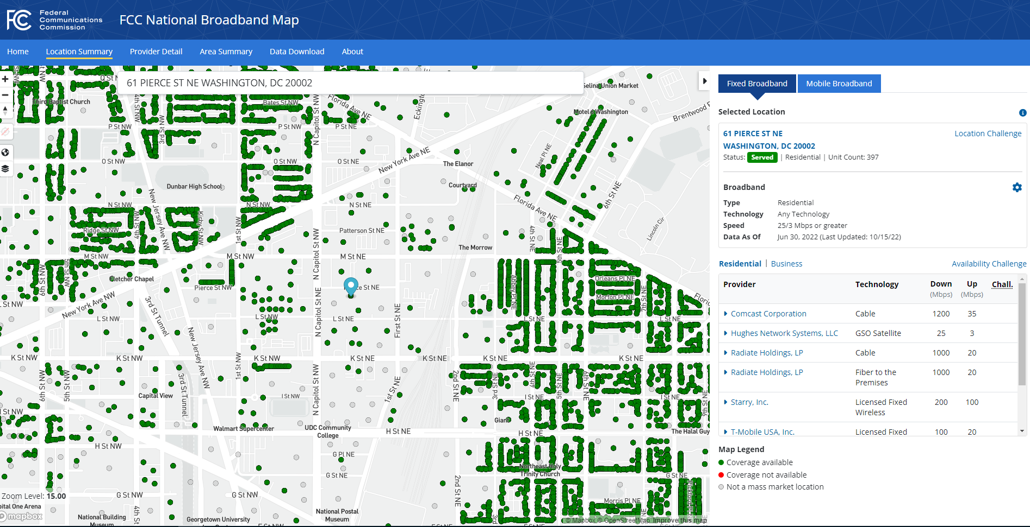
National Broadband Map: Location Challenges
Location points are part of a dataset called the Broadband Serviceable Location Fabric.
What can be challenged?
Wrong address
Wrong unit count
Wrong placement on the map
Misidentified as non-Broadband-Serviceable
Missing location

Slide 9
National Broadband Map: Availability Challenges
Fixed broadband service is “available” at a location if the:
provider has, or previously had, a connection in service to the location.
provider could initiate service through a routine installation within 10 business days of a request with no extraordinary charges or delays attributable to the extension of the provider’s network.

Slide 10
National Broadband Map: Fixed Availability Challenges
Codes identifying the category of or reason for a bulk fixed availability challenge:
1 – Provider Failure to Schedule Install Within 10 Days of Request for Service
2 – Provider Failure to Perform Install Within 10 Days of Request for Service
3 – Provider Demand for Connection Charges That Exceed Its Standard Installation Charge
4 – Provider Denial of Request for Service
5 – Reported Service Type Not Offered
6 – Reported Speed Not Available for Purchase
7 – Subscribed Speed Not Achievable [Individuals only can select this option (on the map), but it won't create a challenge]
8 – Signal Not Available (Satellite / Fixed Wireless only)
9 – Provider Demand for Additional Construction (Satellite / Fixed Wireless only)
10 – Missing Provider [this will not create a challenge, but will be considered as crowdsource data]

Slide 11
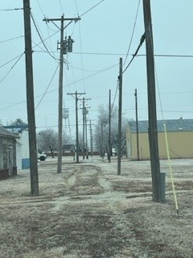
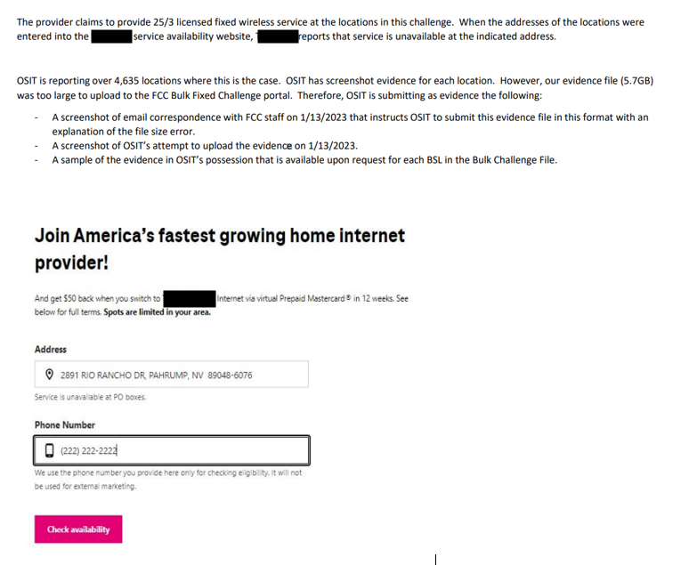
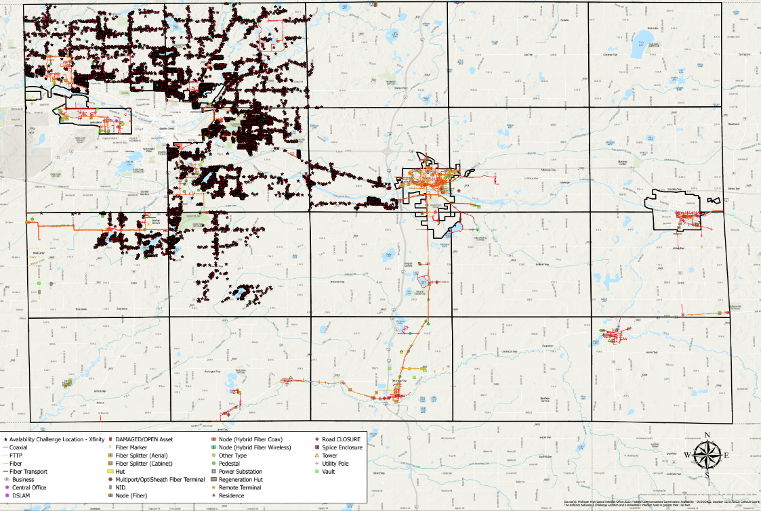
Evidence Supporting Fixed Challenges
Tip: Your evidence should be complete and relate to each challenged location.
Tip: Evidence should support the specific reason code
Tip: Explain your evidence

Slide 12
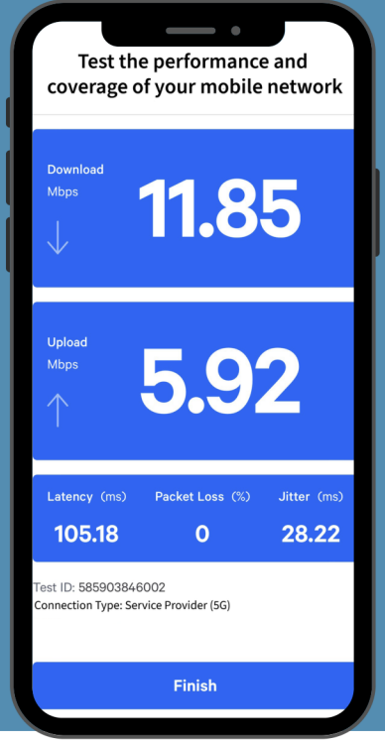
National Broadband Map: Mobile Availability Challenges
Challengers may dispute the availability of mobile broadband service using on-the-ground speed test data.
Speed test data may be submitted using the FCC’s Speed Test app (or another third-party speed test app approved by the FCC’s Office of Engineering and Technology).
Alternatively, bulk availability challengers may submit speed test data collected using their own hardware and software provided it meets FCC’s requirements.

Slide 13
Broadband Data Collection: Resources
For More Information:
www.fcc.gov/BroadbandData

