Slide 1
Tribal Broadband Connectivity Program
December 13, 2023

Slide 2
Tribal Broadband Connectivity Program – Round 2

Slide 3
Tribal Broadband Connectivity Program
 | How Much | Approximately $980 Million
 | Who can apply | Tribal Governments, Tribal organizations, Tribal Colleges or Universities (TCUs), the Department of Hawaiian Home Lands on behalf of the Native Hawaiian Community, and Alaska Native Corporations.
 | For What | To expand broadband adoption and deployment on Tribal lands, as well as to support distance learning, remote work, and telehealth for Tribal citizens.
 | When | NTIA started accepting applications for the Tribal Broadband Connectivity Grants on July 27, 2023. All applications must be received (or postmarked) by January 23, 2024.
DRAFT | PRE-DECISIONAL

Slide 4
Tribal Grant Program |Eligible Entities
Section 905(a)(8) of the Consolidated Appropriations Act, 2021 (Act), stipulates the following eligible entities:
Tribal Governments;
Tribal Colleges or Universities;
The Department of Hawaiian Homelands on behalf of the Native Hawaiian Community, including Native Hawaiian education programs;
Tribal organizations; and
Native corporations as defined under Section 3 of the Alaska Native Claims Settlement Act.
Eligible Entities that previously received Tribal Broadband Connectivity Program grant funding may apply for additional grant funding.
DRAFT | PRE-DECISIONAL

Slide 5
Tribal Grant Program |Eligible Lands
Section 905(a)(13) of the Act defines Tribal Land that can be served as:
any land located within the boundaries of (i) an Indian reservation, pueblo, or rancheria; or (ii) a former reservation within Oklahoma;
any land not located within the boundaries of an Indian reservation, pueblo, or rancheria, the title to which is held—
(i) in trust by the United States for the benefit of an Indian Tribe or an individual Indian;
(ii) by an Indian Tribe or an individual Indian, subject to restriction against alienation under laws of the United States; or
(iii) by a dependent Indian community;
any land located within a region established pursuant to section 7(a) of the Alaska Native Claims Settlement Act (43 U.S.C. 1606(a));
Hawaiian Home Lands, as defined in section 801 of the Native American Housing Assistance and Self- Determination Act of 1996 (25 U.S.C. 4221); or
those areas or communities designated by the Assistant Secretary of Indian Affairs of the Department of the Interior that are near, adjacent, or contiguous to reservations where financial assistance and social service programs are provided to Indians because of their status as Indians.
DRAFT | PRE-DECISIONAL

Slide 6
Tribal Grant Program |Eligible Entities – Equitable Distribution
To meet the equitable distribution requirement of the Act, NTIA will allocate up to $500,000 to each of the Federally Recognized Tribes delineated by the Department of the Interior’s Bureau of Indian Affairs (including those listed parenthetically). These Tribes may receive awards if:
The application passes Initial Administrative and Eligibility Review, Merit Review, and Programmatic Review, and
The applicant or relevant tribal government has not received funding previously under TBCP, or
The consortium applicant represents tribal governments which have not received funding previously under TBCP.
DRAFT | PRE-DECISIONAL

Slide 7
Key Requirements of TBCP
Eligible entities cannot be a part of more than one application
18 months from award for grantee to commit funds
Up to 4-year period of performance for all awards, unless an extension is granted (see next slide)
May only use up to 2% of grant funds received for an eligible entity’s administrative expenses
For Infrastructure Deployment, may only use up to 2.5% of the total project costs for Planning, Feasibility, and Sustainability Studies related to the project
DRAFT | PRE-DECISIONAL

Slide 8
Timeline for TBCP grant projects
The Act provides for a four-year award period from the receipt of grant funds.
Extensions For Infrastructure Projects: The Assistant Secretary may extend the period required for the expenditure of funds under the Tribal Broadband Connectivity Program for an eligible entity that proposes to use the grant funds for construction of broadband infrastructure if the eligible entity certifies that:
the eligible entity has a plan for use of the grant funds;
the construction project is underway; or
extenuating circumstances require an extension of time to allow the project to be completed.
Extensions for Broadband Use and Adoption Projects: The Assistant Secretary may, for good cause shown, extend the period of performance for a use and adoption project based on a detailed showing by the eligible entity of the need for an extension.
DRAFT | PRE-DECISIONAL

Slide 9
Key Changes in NOFO 2
In addition to the technical amendments made under the Bipartisan Infrastructure Law, the following represent the major changes in NOFO 2:
Project Types
Standalone Planning projects are no longer eligible
Standalone Use and Adoption Projects are limited to not more than $100 million.
Eligibility, Prioritization, and Evaluation
Applicants can only be listed in or served through a single application to reduce duplication and confusion
TBCP 2 will prioritize funding for Infrastructure Deployment projects submitted by Planning or Equitable Distribution recipients, followed by applicants not funded by TBCP 1
Equitable Distribution is only available to those tribes who did not receive any funds under TBCP 1
DRAFT | PRE-DECISIONAL

Slide 10
Key Changes in NOFO 2
Eligibility, Prioritization, and Evaluation (continued from slide 15)
Promotion of Workforce Development projects to foster technology-based employment for Tribal members through on-the-job training/certification to increase the availability of technology-related jobs and the skilled knowledge base of the community
Capacity Building replaced Sustainability as an Evaluation Criteria for Use & Adoption to promote development of lasting digital skills, technology-based employment & training, and measurement of its effectiveness
Emphasis on network speed – Proposed networks delivering 1000Mbps receive 14 pts up from 10pts while those proposing the minimum qualifying end-user speed of 25/3Mbps go from 3pts to 1pt.
De-Duplication – New framework for review and potential negotiation informed by TBCP 1 that fortifies data-based analysis of service area via NBAM, FCC Funding Map, and coordination with all relevant agencies to prevent duplicative funding
DRAFT | PRE-DECISIONAL

Slide 11
Key Changes in NOFO 2
Eligibility, Prioritization, and Evaluation (continued from slide 16)
Cybersecurity and Supply Chain – Applicants are required to submit “Certification Regarding Compliance with Cybersecurity and Supply Chain Management Requirements” to enforce applicable Dept and Exec Order standards for cybersecurity and supply chain risk management
OIG Compliance – New requirements for Disclosures, Reporting, Whistleblower Protection, and Enforcement have been added
Mapping and Duplication of Efforts
Shapefiles are now required for all TBCP 2 Infrastructure Deployment applicants
Applicants must “self certify” to officially disclose all current and/or terminated Enforceable Buildout Commitments, broadband facilities or equipment on Tribal Land, and evidence of a challenge to the FCC’s National Broadband Map if it does not reflect the Tribe’s unserved status
DRAFT | PRE-DECISIONAL

Slide 12
Prioritization of Applications
Prioritizing applications in Round 2 by the following:
Department of Hawaiian Homelands
Standalone UA projects for those that did not receive funding in Round 1
Standalone ID projects for Planning or ED awardees in Round 1
Standalone ID projects that did not receive funding in Round 1
Dual ID and UA projects that did not receive funding in Round 1
Remaining awards for eligible ED recipients
If funding is available, NTIA will consider ID awards for Round 1 award recipients
DRAFT | PRE-DECISIONAL

Slide 13
Tribal Broadband Connectivity Program Eligible Projects

Slide 14
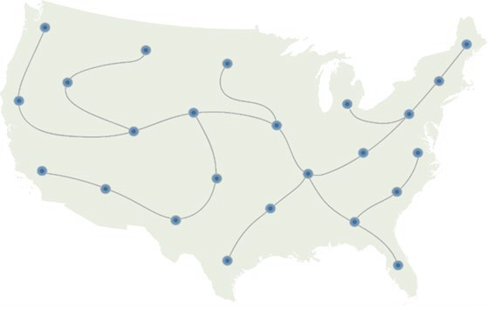
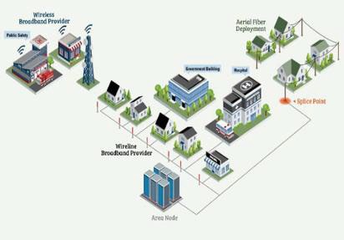
Eligible Projects - Infrastructure
Middle mile
Last mile
Submarine cable landing stations
Projects cannot:
Duplicate previous federal funding
Rely on future satellite connections
DRAFT | PRE-DECISIONAL

Slide 15
Eligible Projects - Adoption and Use
Projects that promote the adoption and use of broadband services, including:
affordable broadband programs, such as providing free or reduced-cost broadband service and preventing disconnection of existing broadband service
distance learning
telehealth
digital inclusion efforts
broadband adoption activities
DRAFT | PRE-DECISIONAL

Slide 16
Examples of Digital Inclusion Programs
Access / Affordability
Discounted Broadband, Public WiFi, Cell on Wheels (COWs), Mobile Hotspots, Internet in Public / Affordable Housing, WiFi Buses, FCC’s Affordable Connectivity Program promotion*
Devices
School Laptop Programs, Refurbished Computers, Discount Computers, Laptop Lending, Public Computer Centers, Mobile Computer Labs
Technical Help and Support
Tech Support Hotlines, Digital Connectors / Navigators, Technology Organizers, Volunteers, Community Tech Events
Digital Skills Training
Digital Literacy, Online Safety, Workforce Training and Apprenticeships, Health, STEM/STEAM
*Important Note: No Use and Adoption projects may include activities which require NEPA/NHPA clearance
DRAFT | PRE-DECISIONAL

Slide 17
Broadband Resources

Slide 18
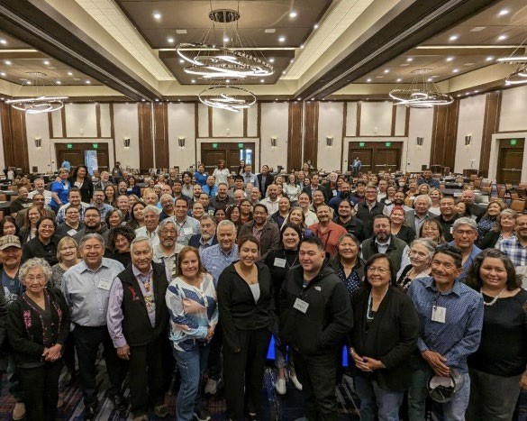
Tribal Broadband Leaders Network
One-stop shop for resources on broadband efforts on Tribal Land
Active network of Tribal leaders leading broadband efforts
Channel for communication and review of polices between federal agencies and Tribes
To join TBLN, email tbln@ntia.gov
DRAFT | PRE-DECISIONAL

Slide 19
Additional Resources
Tribal Broadband Planning Toolkit
Digital Equity in Tribal Communities
Broadband Asset Management and Mapping Guide
Internet For All – Funding Search
DRAFT | PRE-DECISIONAL

Slide 20
THANK YOU

